Slide 1

.NET Core: Developing Cross-Platform Web Apps with ASP.NET Core – WorkshopPLUS
< Engineer Name >
Premier Field Engineer
v3.1

Slide 3
How to View This Presentation
To switch to Notes Page view:
On the ribbon, click the View tab, and then click Notes Page
To navigate through notes, use the Page Up and Page Down keys
Zoom in or zoom out, if required
In the Notes Page view, you can:
Read any supporting text
Terminology List—a list of terms used in this course is provided in the Notes section
Add notes to your copy of the presentation, if required
Take the presentation files home with you

Slide 4
Module 3: Controllers
Module Overview
Notes:
After completing this module, you will be able to:
Understand Controllers and their role in the MVC pattern.
Create controllers and action methods.
Understand Action Method Return Types
Discuss Model Binding and how we pass parameters to our actions.
After that we talk about Action Filters.
Finally we’ll talk at length about the concept of Dependency Injection and how it applies to Controllers.

Slide 5
Module 3: Controllers
Section 1: Controller Fundamentals
Lesson: Role of Controllers
Notes:
Overview:
Understand the fundamentals of controllers, their role in MVC, and how to extend controllers.

Slide 6
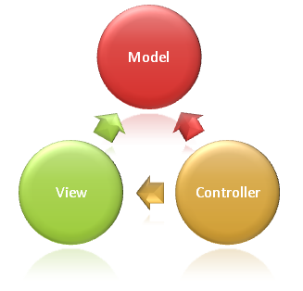
C is for Controllers
Notes:
Start by bringing us back to the three components of MVC. Models, Views, and Controllers
Notice the arrows in the diagram and how both the View and the Controller depend on the model.
During a typical flow, our requests will start with a Controller, that Controller will work with our model, and select a View to render.
Our Controller is the component that controls nearly all the action of what happens with a request throughout the lifecycle of our request.
In the MVC Pattern, the controller is the initial entry point, is responsible for selecting which models to work with, and which view to render to the user.
https://docs.microsoft.com/en-us/aspnet/core/mvc/overview?view=aspnetcore-3.1

Slide 7
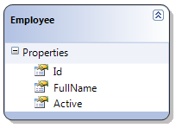
Role of Controllers
Controllers are the initial entry point for a given request
Responsible for:
Handling and responding to user input and interaction
Selecting which model types to work with
Selecting which view to render in response
Controller
(Input)
View
(Presentation)
Notes:
Controllers are the initial entry point for a given request
Responsible for:
Handling and responding to user input and interaction
Selecting which model types to work with
Selecting which view to render in response
The most important of these is the “Handling and responding to user input and interaction”.
It is in our Controllers that govern the entire processing of a request
This diagram has been in previous slide decks This is our basic flow
Controller handles Input, Creates a Model Type (Employee) and then generates the View to render our response.
There may be other steps that occur in our pipeline earlier thru middleware such as Authentication, but this is the starting point unique to our request.

Slide 8
Role of Controllers (cont)
Controllers are classes and are used to define and group a set of actions.
Actions are methods on a controller which handle requests.
Controllers logically group similar actions or functionality together.
Allows common set of rules, such as routing, caching and authorization to be applied collective.
Notes:
Controllers are classes and are used to define and group a set of actions.
Actions are our actual methods that we implement to handle specific requests.
Example:
Imagine we had a Music Store application and we had a number of products.
Our Web Application maybe needs to have some functionality to Add and Edit products in our database.
In this situation we’d may have a “Product” controller which would be defined as a Class in our application.
That Product class may have an Edit method which is our Action method for editing a given Product
This method will likely have parameters for WHICH product to edit, and then the properties to edit.
Controllers should logically group similar actions and functionality together.
In our previous example, actions and functionality related to Products should be groups into the Product controller
This grouping allows for us to apply common sets of rules such as Routing, Caching, Authorization, some of which we’ll talk about more throughout the class.

Slide 9
Role of Controller Example
Example
User sends a URL request with query string values
Controller is triggered against the request
Controller handles query-string values
Controller passes the values to the model
Model uses the value to query the database and returns the results
Controller selects a View to render the UI
Controller returns the View to the requesting browser
Notes:
Remember: Controllers handle and respond to user input and interaction.
here’s an example of the steps that may occur during the processing of a request.
Read thru each of the 7 steps.
Consider using our Product controller example before.
Reiterate how Controller controls the action here by passing data to Model, selecting a view, and returning the request to the browser.

Slide 10
Module 3: Controllers
Section 2: Developing Controllers
Lesson: Basics
Notes:
Overview:
Now that we understand a bit about what a Controller is, let’s discuss developing Controllers.

Slide 11


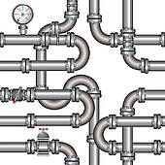
MVC request “Under the hood”
Routing
HTTP Request
Execute the request pipeline
Controller
Factory
Controller
MVC
Action
Invoker
Action
Method
Notes:
Before we dig deeper into Developing Controllers, want to understand some of the components Under the Hood
Our Initial Step is Routing, which again we’ll talk about more during a later section
This step we have a request come in with a particular URL
Routing determines what Controller is needed and Instantiates our Controller Factory
The Controller Factory “Activates” our Controller and performs an initialization.
Once the Controller is Created, we have the Action Invoker. The Action Invoker is what calls our Action Method
The process of creating our Controller, and Calling our Action method may involve other steps.
We maybe need to call some Action Filters, which we’ll discuss more a bit later
We may need to instantiate or retrieve some services, which we will pass in thru dependency injection
The key takeaways here is that we have
Routing which aids in determining which Controller & Action methods to call
We have Controller Factory which creates our Controller by calling its contructor and passes it any necessary parameters
And we have an Action invoke which handles any parameters necessary for calling our Action method.
If you stick a breakpoint in the Controller Constructor, you’ll see the calls to the Controller Factory
If you stick a breakpoint in the Controller Action Method, you’ll see the Action Invoker calls.

Slide 12
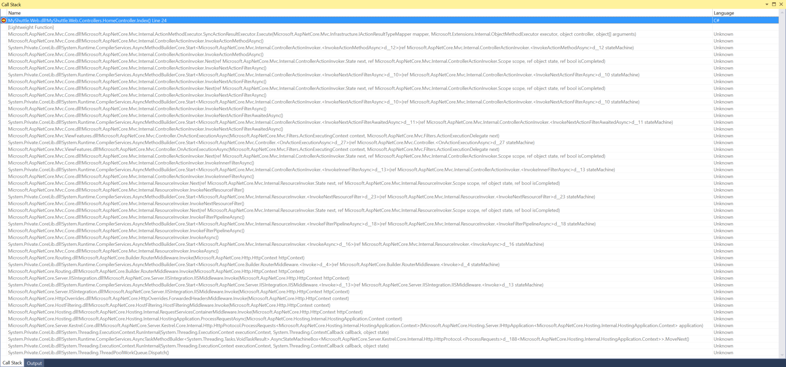
Actual MVC request captured in Visual Studio
> MyShuttle.Web.dll!MyShuttle.Web.Controllers.HomeController.Index() Line 24 C#
[Lightweight Function]
Microsoft.AspNetCore.Mvc.Core.dll!Microsoft.AspNetCore.Mvc.Internal.ActionMethodExecutor.SyncActionResultExecutor.Execute(Microsoft.AspNetCore.Mvc.Infrastructure.IActionResultTypeMapper mapper, Microsoft.Extensions.Internal.ObjectMethodExecutor executor, object controller, object[] arguments) Unknown
Microsoft.AspNetCore.Mvc.Core.dll!Microsoft.AspNetCore.Mvc.Internal.ControllerActionInvoker.InvokeActionMethodAsync() Unknown
System.Private.CoreLib.dll!System.Runtime.CompilerServices.AsyncMethodBuilderCore.Start<Microsoft.AspNetCore.Mvc.Internal.ControllerActionInvoker.<InvokeActionMethodAsync>d__12>(ref Microsoft.AspNetCore.Mvc.Internal.ControllerActionInvoker.<InvokeActionMethodAsync>d__12 stateMachine) Unknown
Microsoft.AspNetCore.Mvc.Core.dll!Microsoft.AspNetCore.Mvc.Internal.ControllerActionInvoker.InvokeActionMethodAsync() Unknown
Microsoft.AspNetCore.Mvc.Core.dll!Microsoft.AspNetCore.Mvc.Internal.ControllerActionInvoker.Next(ref Microsoft.AspNetCore.Mvc.Internal.ControllerActionInvoker.State next, ref Microsoft.AspNetCore.Mvc.Internal.ControllerActionInvoker.Scope scope, ref object state, ref bool isCompleted) Unknown
Microsoft.AspNetCore.Mvc.Core.dll!Microsoft.AspNetCore.Mvc.Internal.ControllerActionInvoker.InvokeNextActionFilterAsync() Unknown
System.Private.CoreLib.dll!System.Runtime.CompilerServices.AsyncMethodBuilderCore.Start<Microsoft.AspNetCore.Mvc.Internal.ControllerActionInvoker.<InvokeNextActionFilterAsync>d__10>(ref Microsoft.AspNetCore.Mvc.Internal.ControllerActionInvoker.<InvokeNextActionFilterAsync>d__10 stateMachine) Unknown
Microsoft.AspNetCore.Mvc.Core.dll!Microsoft.AspNetCore.Mvc.Internal.ControllerActionInvoker.InvokeNextActionFilterAsync() Unknown
Microsoft.AspNetCore.Mvc.Core.dll!Microsoft.AspNetCore.Mvc.Internal.ControllerActionInvoker.Next(ref Microsoft.AspNetCore.Mvc.Internal.ControllerActionInvoker.State next, ref Microsoft.AspNetCore.Mvc.Internal.ControllerActionInvoker.Scope scope, ref object state, ref bool isCompleted) Unknown
Microsoft.AspNetCore.Mvc.Core.dll!Microsoft.AspNetCore.Mvc.Internal.ControllerActionInvoker.InvokeNextActionFilterAsync() Unknown
System.Private.CoreLib.dll!System.Runtime.CompilerServices.AsyncMethodBuilderCore.Start<Microsoft.AspNetCore.Mvc.Internal.ControllerActionInvoker.<InvokeNextActionFilterAsync>d__10>(ref Microsoft.AspNetCore.Mvc.Internal.ControllerActionInvoker.<InvokeNextActionFilterAsync>d__10 stateMachine) Unknown
Microsoft.AspNetCore.Mvc.Core.dll!Microsoft.AspNetCore.Mvc.Internal.ControllerActionInvoker.InvokeNextActionFilterAsync() Unknown
Microsoft.AspNetCore.Mvc.Core.dll!Microsoft.AspNetCore.Mvc.Internal.ControllerActionInvoker.InvokeNextActionFilterAwaitedAsync() Unknown
System.Private.CoreLib.dll!System.Runtime.CompilerServices.AsyncMethodBuilderCore.Start<Microsoft.AspNetCore.Mvc.Internal.ControllerActionInvoker.<InvokeNextActionFilterAwaitedAsync>d__11>(ref Microsoft.AspNetCore.Mvc.Internal.ControllerActionInvoker.<InvokeNextActionFilterAwaitedAsync>d__11 stateMachine) Unknown
Microsoft.AspNetCore.Mvc.Core.dll!Microsoft.AspNetCore.Mvc.Internal.ControllerActionInvoker.InvokeNextActionFilterAwaitedAsync() Unknown
Microsoft.AspNetCore.Mvc.ViewFeatures.dll!Microsoft.AspNetCore.Mvc.Controller.OnActionExecutionAsync(Microsoft.AspNetCore.Mvc.Filters.ActionExecutingContext context, Microsoft.AspNetCore.Mvc.Filters.ActionExecutionDelegate next) Unknown
System.Private.CoreLib.dll!System.Runtime.CompilerServices.AsyncMethodBuilderCore.Start<Microsoft.AspNetCore.Mvc.Controller.<OnActionExecutionAsync>d__27>(ref Microsoft.AspNetCore.Mvc.Controller.<OnActionExecutionAsync>d__27 stateMachine) Unknown
Microsoft.AspNetCore.Mvc.ViewFeatures.dll!Microsoft.AspNetCore.Mvc.Controller.OnActionExecutionAsync(Microsoft.AspNetCore.Mvc.Filters.ActionExecutingContext context, Microsoft.AspNetCore.Mvc.Filters.ActionExecutionDelegate next) Unknown
Microsoft.AspNetCore.Mvc.Core.dll!Microsoft.AspNetCore.Mvc.Internal.ControllerActionInvoker.Next(ref Microsoft.AspNetCore.Mvc.Internal.ControllerActionInvoker.State next, ref Microsoft.AspNetCore.Mvc.Internal.ControllerActionInvoker.Scope scope, ref object state, ref bool isCompleted) Unknown
Microsoft.AspNetCore.Mvc.Core.dll!Microsoft.AspNetCore.Mvc.Internal.ControllerActionInvoker.InvokeInnerFilterAsync() Unknown
System.Private.CoreLib.dll!System.Runtime.CompilerServices.AsyncMethodBuilderCore.Start<Microsoft.AspNetCore.Mvc.Internal.ControllerActionInvoker.<InvokeInnerFilterAsync>d__13>(ref Microsoft.AspNetCore.Mvc.Internal.ControllerActionInvoker.<InvokeInnerFilterAsync>d__13 stateMachine) Unknown
Microsoft.AspNetCore.Mvc.Core.dll!Microsoft.AspNetCore.Mvc.Internal.ControllerActionInvoker.InvokeInnerFilterAsync() Unknown
Microsoft.AspNetCore.Mvc.Core.dll!Microsoft.AspNetCore.Mvc.Internal.ResourceInvoker.Next(ref Microsoft.AspNetCore.Mvc.Internal.ResourceInvoker.State next, ref Microsoft.AspNetCore.Mvc.Internal.ResourceInvoker.Scope scope, ref object state, ref bool isCompleted) Unknown
Microsoft.AspNetCore.Mvc.Core.dll!Microsoft.AspNetCore.Mvc.Internal.ResourceInvoker.InvokeNextResourceFilter() Unknown
System.Private.CoreLib.dll!System.Runtime.CompilerServices.AsyncMethodBuilderCore.Start<Microsoft.AspNetCore.Mvc.Internal.ResourceInvoker.<InvokeNextResourceFilter>d__23>(ref Microsoft.AspNetCore.Mvc.Internal.ResourceInvoker.<InvokeNextResourceFilter>d__23 stateMachine) Unknown
Microsoft.AspNetCore.Mvc.Core.dll!Microsoft.AspNetCore.Mvc.Internal.ResourceInvoker.InvokeNextResourceFilter() Unknown
Microsoft.AspNetCore.Mvc.Core.dll!Microsoft.AspNetCore.Mvc.Internal.ResourceInvoker.Next(ref Microsoft.AspNetCore.Mvc.Internal.ResourceInvoker.State next, ref Microsoft.AspNetCore.Mvc.Internal.ResourceInvoker.Scope scope, ref object state, ref bool isCompleted) Unknown
Microsoft.AspNetCore.Mvc.Core.dll!Microsoft.AspNetCore.Mvc.Internal.ResourceInvoker.InvokeFilterPipelineAsync() Unknown
System.Private.CoreLib.dll!System.Runtime.CompilerServices.AsyncMethodBuilderCore.Start<Microsoft.AspNetCore.Mvc.Internal.ResourceInvoker.<InvokeFilterPipelineAsync>d__18>(ref Microsoft.AspNetCore.Mvc.Internal.ResourceInvoker.<InvokeFilterPipelineAsync>d__18 stateMachine) Unknown
Microsoft.AspNetCore.Mvc.Core.dll!Microsoft.AspNetCore.Mvc.Internal.ResourceInvoker.InvokeFilterPipelineAsync() Unknown
Microsoft.AspNetCore.Mvc.Core.dll!Microsoft.AspNetCore.Mvc.Internal.ResourceInvoker.InvokeAsync() Unknown
System.Private.CoreLib.dll!System.Runtime.CompilerServices.AsyncMethodBuilderCore.Start<Microsoft.AspNetCore.Mvc.Internal.ResourceInvoker.<InvokeAsync>d__16>(ref Microsoft.AspNetCore.Mvc.Internal.ResourceInvoker.<InvokeAsync>d__16 stateMachine) Unknown
Microsoft.AspNetCore.Mvc.Core.dll!Microsoft.AspNetCore.Mvc.Internal.ResourceInvoker.InvokeAsync() Unknown
Microsoft.AspNetCore.Routing.dll!Microsoft.AspNetCore.Builder.RouterMiddleware.Invoke(Microsoft.AspNetCore.Http.HttpContext httpContext) Unknown
System.Private.CoreLib.dll!System.Runtime.CompilerServices.AsyncMethodBuilderCore.Start<Microsoft.AspNetCore.Builder.RouterMiddleware.<Invoke>d__4>(ref Microsoft.AspNetCore.Builder.RouterMiddleware.<Invoke>d__4 stateMachine) Unknown
Microsoft.AspNetCore.Routing.dll!Microsoft.AspNetCore.Builder.RouterMiddleware.Invoke(Microsoft.AspNetCore.Http.HttpContext httpContext) Unknown
Microsoft.AspNetCore.Server.IISIntegration.dll!Microsoft.AspNetCore.Server.IISIntegration.IISMiddleware.Invoke(Microsoft.AspNetCore.Http.HttpContext httpContext) Unknown
System.Private.CoreLib.dll!System.Runtime.CompilerServices.AsyncMethodBuilderCore.Start<Microsoft.AspNetCore.Server.IISIntegration.IISMiddleware.<Invoke>d__13>(ref Microsoft.AspNetCore.Server.IISIntegration.IISMiddleware.<Invoke>d__13 stateMachine) Unknown
Microsoft.AspNetCore.Server.IISIntegration.dll!Microsoft.AspNetCore.Server.IISIntegration.IISMiddleware.Invoke(Microsoft.AspNetCore.Http.HttpContext httpContext) Unknown
Microsoft.AspNetCore.HttpOverrides.dll!Microsoft.AspNetCore.HttpOverrides.ForwardedHeadersMiddleware.Invoke(Microsoft.AspNetCore.Http.HttpContext context) Unknown
Microsoft.AspNetCore.HostFiltering.dll!Microsoft.AspNetCore.HostFiltering.HostFilteringMiddleware.Invoke(Microsoft.AspNetCore.Http.HttpContext context) Unknown
Microsoft.AspNetCore.Hosting.dll!Microsoft.AspNetCore.Hosting.Internal.RequestServicesContainerMiddleware.Invoke(Microsoft.AspNetCore.Http.HttpContext httpContext) Unknown
Microsoft.AspNetCore.Hosting.dll!Microsoft.AspNetCore.Hosting.Internal.HostingApplication.ProcessRequestAsync(Microsoft.AspNetCore.Hosting.Internal.HostingApplication.Context context) Unknown
Microsoft.AspNetCore.Server.Kestrel.Core.dll!Microsoft.AspNetCore.Server.Kestrel.Core.Internal.Http.HttpProtocol.ProcessRequests<Microsoft.AspNetCore.Hosting.Internal.HostingApplication.Context>(Microsoft.AspNetCore.Hosting.Server.IHttpApplication<Microsoft.AspNetCore.Hosting.Internal.HostingApplication.Context> application) Unknown
System.Private.CoreLib.dll!System.Threading.ExecutionContext.RunInternal(System.Threading.ExecutionContext executionContext, System.Threading.ContextCallback callback, object state) Unknown
System.Private.CoreLib.dll!System.Runtime.CompilerServices.AsyncTaskMethodBuilder<System.Threading.Tasks.VoidTaskResult>.AsyncStateMachineBox<Microsoft.AspNetCore.Server.Kestrel.Core.Internal.Http.HttpProtocol.<ProcessRequests>d__188<Microsoft.AspNetCore.Hosting.Internal.HostingApplication.Context>>.MoveNext() Unknown
System.Private.CoreLib.dll!System.Threading.ExecutionContext.RunInternal(System.Threading.ExecutionContext executionContext, System.Threading.ContextCallback callback, object state) Unknown
System.Private.CoreLib.dll!System.Threading.ThreadPoolWorkQueue.Dispatch() Unknown
Notes:
This is obviously difficult to see, but this is an image of a breakpoint for the HomeController class for Method Index().
So Home is our Controller, Index is our Action.
Let’s look at some of these calls
<slide>

Slide 13
Actual MVC request captured in Visual Studio
> MyShuttle.Web.dll!MyShuttle.Web.Controllers.HomeController.Index() Line 24 C#
[Lightweight Function]
Microsoft.AspNetCore.Mvc.Core.dll!Microsoft.AspNetCore.Mvc.Internal.ActionMethodExecutor.SyncActionResultExecutor.Execute(Microsoft.AspNetCore.Mvc.Infrastructure.IActionResultTypeMapper mapper, Microsoft.Extensions.Internal.ObjectMethodExecutor executor, object controller, object[] arguments) Unknown
Microsoft.AspNetCore.Mvc.Core.dll!Microsoft.AspNetCore.Mvc.Internal.ControllerActionInvoker.InvokeActionMethodAsync() Unknown
System.Private.CoreLib.dll!System.Runtime.CompilerServices.AsyncMethodBuilderCore.Start<Microsoft.AspNetCore.Mvc.Internal.ControllerActionInvoker.<InvokeActionMethodAsync>d__12>(ref Microsoft.AspNetCore.Mvc.Internal.ControllerActionInvoker.<InvokeActionMethodAsync>d__12 stateMachine) Unknown
Microsoft.AspNetCore.Mvc.Core.dll!Microsoft.AspNetCore.Mvc.Internal.ControllerActionInvoker.InvokeActionMethodAsync() Unknown
Microsoft.AspNetCore.Mvc.Core.dll!Microsoft.AspNetCore.Mvc.Internal.ControllerActionInvoker.Next(ref Microsoft.AspNetCore.Mvc.Internal.ControllerActionInvoker.State next, ref Microsoft.AspNetCore.Mvc.Internal.ControllerActionInvoker.Scope scope, ref object state, ref bool isCompleted) Unknown
Microsoft.AspNetCore.Mvc.Core.dll!Microsoft.AspNetCore.Mvc.Internal.ControllerActionInvoker.InvokeNextActionFilterAsync() Unknown
System.Private.CoreLib.dll!System.Runtime.CompilerServices.AsyncMethodBuilderCore.Start<Microsoft.AspNetCore.Mvc.Internal.ControllerActionInvoker.<InvokeNextActionFilterAsync>d__10>(ref Microsoft.AspNetCore.Mvc.Internal.ControllerActionInvoker.<InvokeNextActionFilterAsync>d__10 stateMachine) Unknown
Microsoft.AspNetCore.Mvc.Core.dll!Microsoft.AspNetCore.Mvc.Internal.ControllerActionInvoker.InvokeNextActionFilterAsync() Unknown
Microsoft.AspNetCore.Mvc.Core.dll!Microsoft.AspNetCore.Mvc.Internal.ControllerActionInvoker.Next(ref Microsoft.AspNetCore.Mvc.Internal.ControllerActionInvoker.State next, ref Microsoft.AspNetCore.Mvc.Internal.ControllerActionInvoker.Scope scope, ref object state, ref bool isCompleted) Unknown
Microsoft.AspNetCore.Mvc.Core.dll!Microsoft.AspNetCore.Mvc.Internal.ControllerActionInvoker.InvokeNextActionFilterAsync() Unknown
System.Private.CoreLib.dll!System.Runtime.CompilerServices.AsyncMethodBuilderCore.Start<Microsoft.AspNetCore.Mvc.Internal.ControllerActionInvoker.<InvokeNextActionFilterAsync>d__10>(ref Microsoft.AspNetCore.Mvc.Internal.ControllerActionInvoker.<InvokeNextActionFilterAsync>d__10 stateMachine) Unknown
Microsoft.AspNetCore.Mvc.Core.dll!Microsoft.AspNetCore.Mvc.Internal.ControllerActionInvoker.InvokeNextActionFilterAsync() Unknown
Microsoft.AspNetCore.Mvc.Core.dll!Microsoft.AspNetCore.Mvc.Internal.ControllerActionInvoker.InvokeNextActionFilterAwaitedAsync() Unknown
System.Private.CoreLib.dll!System.Runtime.CompilerServices.AsyncMethodBuilderCore.Start<Microsoft.AspNetCore.Mvc.Internal.ControllerActionInvoker.<InvokeNextActionFilterAwaitedAsync>d__11>(ref Microsoft.AspNetCore.Mvc.Internal.ControllerActionInvoker.<InvokeNextActionFilterAwaitedAsync>d__11 stateMachine) Unknown
Microsoft.AspNetCore.Mvc.Core.dll!Microsoft.AspNetCore.Mvc.Internal.ControllerActionInvoker.InvokeNextActionFilterAwaitedAsync() Unknown
Microsoft.AspNetCore.Mvc.ViewFeatures.dll!Microsoft.AspNetCore.Mvc.Controller.OnActionExecutionAsync(Microsoft.AspNetCore.Mvc.Filters.ActionExecutingContext context, Microsoft.AspNetCore.Mvc.Filters.ActionExecutionDelegate next) Unknown
System.Private.CoreLib.dll!System.Runtime.CompilerServices.AsyncMethodBuilderCore.Start<Microsoft.AspNetCore.Mvc.Controller.<OnActionExecutionAsync>d__27>(ref Microsoft.AspNetCore.Mvc.Controller.<OnActionExecutionAsync>d__27 stateMachine) Unknown
Microsoft.AspNetCore.Mvc.ViewFeatures.dll!Microsoft.AspNetCore.Mvc.Controller.OnActionExecutionAsync(Microsoft.AspNetCore.Mvc.Filters.ActionExecutingContext context, Microsoft.AspNetCore.Mvc.Filters.ActionExecutionDelegate next) Unknown
Microsoft.AspNetCore.Mvc.Core.dll!Microsoft.AspNetCore.Mvc.Internal.ControllerActionInvoker.Next(ref Microsoft.AspNetCore.Mvc.Internal.ControllerActionInvoker.State next, ref Microsoft.AspNetCore.Mvc.Internal.ControllerActionInvoker.Scope scope, ref object state, ref bool isCompleted) Unknown
Microsoft.AspNetCore.Mvc.Core.dll!Microsoft.AspNetCore.Mvc.Internal.ControllerActionInvoker.InvokeInnerFilterAsync() Unknown
System.Private.CoreLib.dll!System.Runtime.CompilerServices.AsyncMethodBuilderCore.Start<Microsoft.AspNetCore.Mvc.Internal.ControllerActionInvoker.<InvokeInnerFilterAsync>d__13>(ref Microsoft.AspNetCore.Mvc.Internal.ControllerActionInvoker.<InvokeInnerFilterAsync>d__13 stateMachine) Unknown
Microsoft.AspNetCore.Mvc.Core.dll!Microsoft.AspNetCore.Mvc.Internal.ControllerActionInvoker.InvokeInnerFilterAsync() Unknown
Microsoft.AspNetCore.Mvc.Core.dll!Microsoft.AspNetCore.Mvc.Internal.ResourceInvoker.Next(ref Microsoft.AspNetCore.Mvc.Internal.ResourceInvoker.State next, ref Microsoft.AspNetCore.Mvc.Internal.ResourceInvoker.Scope scope, ref object state, ref bool isCompleted) Unknown
Microsoft.AspNetCore.Mvc.Core.dll!Microsoft.AspNetCore.Mvc.Internal.ResourceInvoker.InvokeNextResourceFilter() Unknown
System.Private.CoreLib.dll!System.Runtime.CompilerServices.AsyncMethodBuilderCore.Start<Microsoft.AspNetCore.Mvc.Internal.ResourceInvoker.<InvokeNextResourceFilter>d__23>(ref Microsoft.AspNetCore.Mvc.Internal.ResourceInvoker.<InvokeNextResourceFilter>d__23 stateMachine) Unknown
Microsoft.AspNetCore.Mvc.Core.dll!Microsoft.AspNetCore.Mvc.Internal.ResourceInvoker.InvokeNextResourceFilter() Unknown
Microsoft.AspNetCore.Mvc.Core.dll!Microsoft.AspNetCore.Mvc.Internal.ResourceInvoker.Next(ref Microsoft.AspNetCore.Mvc.Internal.ResourceInvoker.State next, ref Microsoft.AspNetCore.Mvc.Internal.ResourceInvoker.Scope scope, ref object state, ref bool isCompleted) Unknown
Microsoft.AspNetCore.Mvc.Core.dll!Microsoft.AspNetCore.Mvc.Internal.ResourceInvoker.InvokeFilterPipelineAsync() Unknown
System.Private.CoreLib.dll!System.Runtime.CompilerServices.AsyncMethodBuilderCore.Start<Microsoft.AspNetCore.Mvc.Internal.ResourceInvoker.<InvokeFilterPipelineAsync>d__18>(ref Microsoft.AspNetCore.Mvc.Internal.ResourceInvoker.<InvokeFilterPipelineAsync>d__18 stateMachine) Unknown
Microsoft.AspNetCore.Mvc.Core.dll!Microsoft.AspNetCore.Mvc.Internal.ResourceInvoker.InvokeFilterPipelineAsync() Unknown
Microsoft.AspNetCore.Mvc.Core.dll!Microsoft.AspNetCore.Mvc.Internal.ResourceInvoker.InvokeAsync() Unknown
System.Private.CoreLib.dll!System.Runtime.CompilerServices.AsyncMethodBuilderCore.Start<Microsoft.AspNetCore.Mvc.Internal.ResourceInvoker.<InvokeAsync>d__16>(ref Microsoft.AspNetCore.Mvc.Internal.ResourceInvoker.<InvokeAsync>d__16 stateMachine) Unknown
Microsoft.AspNetCore.Mvc.Core.dll!Microsoft.AspNetCore.Mvc.Internal.ResourceInvoker.InvokeAsync() Unknown
Microsoft.AspNetCore.Routing.dll!Microsoft.AspNetCore.Builder.RouterMiddleware.Invoke(Microsoft.AspNetCore.Http.HttpContext httpContext) Unknown
System.Private.CoreLib.dll!System.Runtime.CompilerServices.AsyncMethodBuilderCore.Start<Microsoft.AspNetCore.Builder.RouterMiddleware.<Invoke>d__4>(ref Microsoft.AspNetCore.Builder.RouterMiddleware.<Invoke>d__4 stateMachine) Unknown
Microsoft.AspNetCore.Routing.dll!Microsoft.AspNetCore.Builder.RouterMiddleware.Invoke(Microsoft.AspNetCore.Http.HttpContext httpContext) Unknown
Microsoft.AspNetCore.Server.IISIntegration.dll!Microsoft.AspNetCore.Server.IISIntegration.IISMiddleware.Invoke(Microsoft.AspNetCore.Http.HttpContext httpContext) Unknown
System.Private.CoreLib.dll!System.Runtime.CompilerServices.AsyncMethodBuilderCore.Start<Microsoft.AspNetCore.Server.IISIntegration.IISMiddleware.<Invoke>d__13>(ref Microsoft.AspNetCore.Server.IISIntegration.IISMiddleware.<Invoke>d__13 stateMachine) Unknown
Microsoft.AspNetCore.Server.IISIntegration.dll!Microsoft.AspNetCore.Server.IISIntegration.IISMiddleware.Invoke(Microsoft.AspNetCore.Http.HttpContext httpContext) Unknown
Microsoft.AspNetCore.HttpOverrides.dll!Microsoft.AspNetCore.HttpOverrides.ForwardedHeadersMiddleware.Invoke(Microsoft.AspNetCore.Http.HttpContext context) Unknown
Microsoft.AspNetCore.HostFiltering.dll!Microsoft.AspNetCore.HostFiltering.HostFilteringMiddleware.Invoke(Microsoft.AspNetCore.Http.HttpContext context) Unknown
Microsoft.AspNetCore.Hosting.dll!Microsoft.AspNetCore.Hosting.Internal.RequestServicesContainerMiddleware.Invoke(Microsoft.AspNetCore.Http.HttpContext httpContext) Unknown
Microsoft.AspNetCore.Hosting.dll!Microsoft.AspNetCore.Hosting.Internal.HostingApplication.ProcessRequestAsync(Microsoft.AspNetCore.Hosting.Internal.HostingApplication.Context context) Unknown
Microsoft.AspNetCore.Server.Kestrel.Core.dll!Microsoft.AspNetCore.Server.Kestrel.Core.Internal.Http.HttpProtocol.ProcessRequests<Microsoft.AspNetCore.Hosting.Internal.HostingApplication.Context>(Microsoft.AspNetCore.Hosting.Server.IHttpApplication<Microsoft.AspNetCore.Hosting.Internal.HostingApplication.Context> application) Unknown
System.Private.CoreLib.dll!System.Threading.ExecutionContext.RunInternal(System.Threading.ExecutionContext executionContext, System.Threading.ContextCallback callback, object state) Unknown
System.Private.CoreLib.dll!System.Runtime.CompilerServices.AsyncTaskMethodBuilder<System.Threading.Tasks.VoidTaskResult>.AsyncStateMachineBox<Microsoft.AspNetCore.Server.Kestrel.Core.Internal.Http.HttpProtocol.<ProcessRequests>d__188<Microsoft.AspNetCore.Hosting.Internal.HostingApplication.Context>>.MoveNext() Unknown
System.Private.CoreLib.dll!System.Threading.ExecutionContext.RunInternal(System.Threading.ExecutionContext executionContext, System.Threading.ContextCallback callback, object state) Unknown
System.Private.CoreLib.dll!System.Threading.ThreadPoolWorkQueue.Dispatch() Unknown
Microsoft.AspNetCore.Mvc.Core.dll!Microsoft.AspNetCore.Mvc.Controllers.ControllerFactoryProvider.CreateControllerFactory.__CreateController
Create Controller Instance that matches request URL
Thread pulled from “thread pool” to process request
System.Private.CoreLib.dll!System.Threading.ThreadPoolWorkQueue.Dispatch()
Notes:
Starting at the bottom, we have System.Threading.ThreadPoolWorkQueue
This is a “Thread pulled from the thread pool to process a request”
We see up above, we have a call to CreateControllerFactory.__CreateController which will
Create a controller instance that matches our request URL.

Slide 14
Actual MVC request captured in Visual Studio
> MyShuttle.Web.dll!MyShuttle.Web.Controllers.HomeController.Index() Line 24 C#
[Lightweight Function]
Microsoft.AspNetCore.Mvc.Core.dll!Microsoft.AspNetCore.Mvc.Internal.ActionMethodExecutor.SyncActionResultExecutor.Execute(Microsoft.AspNetCore.Mvc.Infrastructure.IActionResultTypeMapper mapper, Microsoft.Extensions.Internal.ObjectMethodExecutor executor, object controller, object[] arguments) Unknown
Microsoft.AspNetCore.Mvc.Core.dll!Microsoft.AspNetCore.Mvc.Internal.ControllerActionInvoker.InvokeActionMethodAsync() Unknown
System.Private.CoreLib.dll!System.Runtime.CompilerServices.AsyncMethodBuilderCore.Start<Microsoft.AspNetCore.Mvc.Internal.ControllerActionInvoker.<InvokeActionMethodAsync>d__12>(ref Microsoft.AspNetCore.Mvc.Internal.ControllerActionInvoker.<InvokeActionMethodAsync>d__12 stateMachine) Unknown
Microsoft.AspNetCore.Mvc.Core.dll!Microsoft.AspNetCore.Mvc.Internal.ControllerActionInvoker.InvokeActionMethodAsync() Unknown
Microsoft.AspNetCore.Mvc.Core.dll!Microsoft.AspNetCore.Mvc.Internal.ControllerActionInvoker.Next(ref Microsoft.AspNetCore.Mvc.Internal.ControllerActionInvoker.State next, ref Microsoft.AspNetCore.Mvc.Internal.ControllerActionInvoker.Scope scope, ref object state, ref bool isCompleted) Unknown
Microsoft.AspNetCore.Mvc.Core.dll!Microsoft.AspNetCore.Mvc.Internal.ControllerActionInvoker.InvokeNextActionFilterAsync() Unknown
System.Private.CoreLib.dll!System.Runtime.CompilerServices.AsyncMethodBuilderCore.Start<Microsoft.AspNetCore.Mvc.Internal.ControllerActionInvoker.<InvokeNextActionFilterAsync>d__10>(ref Microsoft.AspNetCore.Mvc.Internal.ControllerActionInvoker.<InvokeNextActionFilterAsync>d__10 stateMachine) Unknown
Microsoft.AspNetCore.Mvc.Core.dll!Microsoft.AspNetCore.Mvc.Internal.ControllerActionInvoker.InvokeNextActionFilterAsync() Unknown
Microsoft.AspNetCore.Mvc.Core.dll!Microsoft.AspNetCore.Mvc.Internal.ControllerActionInvoker.Next(ref Microsoft.AspNetCore.Mvc.Internal.ControllerActionInvoker.State next, ref Microsoft.AspNetCore.Mvc.Internal.ControllerActionInvoker.Scope scope, ref object state, ref bool isCompleted) Unknown
Microsoft.AspNetCore.Mvc.Core.dll!Microsoft.AspNetCore.Mvc.Internal.ControllerActionInvoker.InvokeNextActionFilterAsync() Unknown
System.Private.CoreLib.dll!System.Runtime.CompilerServices.AsyncMethodBuilderCore.Start<Microsoft.AspNetCore.Mvc.Internal.ControllerActionInvoker.<InvokeNextActionFilterAsync>d__10>(ref Microsoft.AspNetCore.Mvc.Internal.ControllerActionInvoker.<InvokeNextActionFilterAsync>d__10 stateMachine) Unknown
Microsoft.AspNetCore.Mvc.Core.dll!Microsoft.AspNetCore.Mvc.Internal.ControllerActionInvoker.InvokeNextActionFilterAsync() Unknown
Microsoft.AspNetCore.Mvc.Core.dll!Microsoft.AspNetCore.Mvc.Internal.ControllerActionInvoker.InvokeNextActionFilterAwaitedAsync() Unknown
System.Private.CoreLib.dll!System.Runtime.CompilerServices.AsyncMethodBuilderCore.Start<Microsoft.AspNetCore.Mvc.Internal.ControllerActionInvoker.<InvokeNextActionFilterAwaitedAsync>d__11>(ref Microsoft.AspNetCore.Mvc.Internal.ControllerActionInvoker.<InvokeNextActionFilterAwaitedAsync>d__11 stateMachine) Unknown
Microsoft.AspNetCore.Mvc.Core.dll!Microsoft.AspNetCore.Mvc.Internal.ControllerActionInvoker.InvokeNextActionFilterAwaitedAsync() Unknown
Microsoft.AspNetCore.Mvc.ViewFeatures.dll!Microsoft.AspNetCore.Mvc.Controller.OnActionExecutionAsync(Microsoft.AspNetCore.Mvc.Filters.ActionExecutingContext context, Microsoft.AspNetCore.Mvc.Filters.ActionExecutionDelegate next) Unknown
System.Private.CoreLib.dll!System.Runtime.CompilerServices.AsyncMethodBuilderCore.Start<Microsoft.AspNetCore.Mvc.Controller.<OnActionExecutionAsync>d__27>(ref Microsoft.AspNetCore.Mvc.Controller.<OnActionExecutionAsync>d__27 stateMachine) Unknown
Microsoft.AspNetCore.Mvc.ViewFeatures.dll!Microsoft.AspNetCore.Mvc.Controller.OnActionExecutionAsync(Microsoft.AspNetCore.Mvc.Filters.ActionExecutingContext context, Microsoft.AspNetCore.Mvc.Filters.ActionExecutionDelegate next) Unknown
Microsoft.AspNetCore.Mvc.Core.dll!Microsoft.AspNetCore.Mvc.Internal.ControllerActionInvoker.Next(ref Microsoft.AspNetCore.Mvc.Internal.ControllerActionInvoker.State next, ref Microsoft.AspNetCore.Mvc.Internal.ControllerActionInvoker.Scope scope, ref object state, ref bool isCompleted) Unknown
Microsoft.AspNetCore.Mvc.Core.dll!Microsoft.AspNetCore.Mvc.Internal.ControllerActionInvoker.InvokeInnerFilterAsync() Unknown
System.Private.CoreLib.dll!System.Runtime.CompilerServices.AsyncMethodBuilderCore.Start<Microsoft.AspNetCore.Mvc.Internal.ControllerActionInvoker.<InvokeInnerFilterAsync>d__13>(ref Microsoft.AspNetCore.Mvc.Internal.ControllerActionInvoker.<InvokeInnerFilterAsync>d__13 stateMachine) Unknown
Microsoft.AspNetCore.Mvc.Core.dll!Microsoft.AspNetCore.Mvc.Internal.ControllerActionInvoker.InvokeInnerFilterAsync() Unknown
Microsoft.AspNetCore.Mvc.Core.dll!Microsoft.AspNetCore.Mvc.Internal.ResourceInvoker.Next(ref Microsoft.AspNetCore.Mvc.Internal.ResourceInvoker.State next, ref Microsoft.AspNetCore.Mvc.Internal.ResourceInvoker.Scope scope, ref object state, ref bool isCompleted) Unknown
Microsoft.AspNetCore.Mvc.Core.dll!Microsoft.AspNetCore.Mvc.Internal.ResourceInvoker.InvokeNextResourceFilter() Unknown
System.Private.CoreLib.dll!System.Runtime.CompilerServices.AsyncMethodBuilderCore.Start<Microsoft.AspNetCore.Mvc.Internal.ResourceInvoker.<InvokeNextResourceFilter>d__23>(ref Microsoft.AspNetCore.Mvc.Internal.ResourceInvoker.<InvokeNextResourceFilter>d__23 stateMachine) Unknown
Microsoft.AspNetCore.Mvc.Core.dll!Microsoft.AspNetCore.Mvc.Internal.ResourceInvoker.InvokeNextResourceFilter() Unknown
Microsoft.AspNetCore.Mvc.Core.dll!Microsoft.AspNetCore.Mvc.Internal.ResourceInvoker.Next(ref Microsoft.AspNetCore.Mvc.Internal.ResourceInvoker.State next, ref Microsoft.AspNetCore.Mvc.Internal.ResourceInvoker.Scope scope, ref object state, ref bool isCompleted) Unknown
Microsoft.AspNetCore.Mvc.Core.dll!Microsoft.AspNetCore.Mvc.Internal.ResourceInvoker.InvokeFilterPipelineAsync() Unknown
System.Private.CoreLib.dll!System.Runtime.CompilerServices.AsyncMethodBuilderCore.Start<Microsoft.AspNetCore.Mvc.Internal.ResourceInvoker.<InvokeFilterPipelineAsync>d__18>(ref Microsoft.AspNetCore.Mvc.Internal.ResourceInvoker.<InvokeFilterPipelineAsync>d__18 stateMachine) Unknown
Microsoft.AspNetCore.Mvc.Core.dll!Microsoft.AspNetCore.Mvc.Internal.ResourceInvoker.InvokeFilterPipelineAsync() Unknown
Microsoft.AspNetCore.Mvc.Core.dll!Microsoft.AspNetCore.Mvc.Internal.ResourceInvoker.InvokeAsync() Unknown
System.Private.CoreLib.dll!System.Runtime.CompilerServices.AsyncMethodBuilderCore.Start<Microsoft.AspNetCore.Mvc.Internal.ResourceInvoker.<InvokeAsync>d__16>(ref Microsoft.AspNetCore.Mvc.Internal.ResourceInvoker.<InvokeAsync>d__16 stateMachine) Unknown
Microsoft.AspNetCore.Mvc.Core.dll!Microsoft.AspNetCore.Mvc.Internal.ResourceInvoker.InvokeAsync() Unknown
Microsoft.AspNetCore.Routing.dll!Microsoft.AspNetCore.Builder.RouterMiddleware.Invoke(Microsoft.AspNetCore.Http.HttpContext httpContext) Unknown
System.Private.CoreLib.dll!System.Runtime.CompilerServices.AsyncMethodBuilderCore.Start<Microsoft.AspNetCore.Builder.RouterMiddleware.<Invoke>d__4>(ref Microsoft.AspNetCore.Builder.RouterMiddleware.<Invoke>d__4 stateMachine) Unknown
Microsoft.AspNetCore.Routing.dll!Microsoft.AspNetCore.Builder.RouterMiddleware.Invoke(Microsoft.AspNetCore.Http.HttpContext httpContext) Unknown
Microsoft.AspNetCore.Server.IISIntegration.dll!Microsoft.AspNetCore.Server.IISIntegration.IISMiddleware.Invoke(Microsoft.AspNetCore.Http.HttpContext httpContext) Unknown
System.Private.CoreLib.dll!System.Runtime.CompilerServices.AsyncMethodBuilderCore.Start<Microsoft.AspNetCore.Server.IISIntegration.IISMiddleware.<Invoke>d__13>(ref Microsoft.AspNetCore.Server.IISIntegration.IISMiddleware.<Invoke>d__13 stateMachine) Unknown
Microsoft.AspNetCore.Server.IISIntegration.dll!Microsoft.AspNetCore.Server.IISIntegration.IISMiddleware.Invoke(Microsoft.AspNetCore.Http.HttpContext httpContext) Unknown
Microsoft.AspNetCore.HttpOverrides.dll!Microsoft.AspNetCore.HttpOverrides.ForwardedHeadersMiddleware.Invoke(Microsoft.AspNetCore.Http.HttpContext context) Unknown
Microsoft.AspNetCore.HostFiltering.dll!Microsoft.AspNetCore.HostFiltering.HostFilteringMiddleware.Invoke(Microsoft.AspNetCore.Http.HttpContext context) Unknown
Microsoft.AspNetCore.Hosting.dll!Microsoft.AspNetCore.Hosting.Internal.RequestServicesContainerMiddleware.Invoke(Microsoft.AspNetCore.Http.HttpContext httpContext) Unknown
Microsoft.AspNetCore.Hosting.dll!Microsoft.AspNetCore.Hosting.Internal.HostingApplication.ProcessRequestAsync(Microsoft.AspNetCore.Hosting.Internal.HostingApplication.Context context) Unknown
Microsoft.AspNetCore.Server.Kestrel.Core.dll!Microsoft.AspNetCore.Server.Kestrel.Core.Internal.Http.HttpProtocol.ProcessRequests<Microsoft.AspNetCore.Hosting.Internal.HostingApplication.Context>(Microsoft.AspNetCore.Hosting.Server.IHttpApplication<Microsoft.AspNetCore.Hosting.Internal.HostingApplication.Context> application) Unknown
System.Private.CoreLib.dll!System.Threading.ExecutionContext.RunInternal(System.Threading.ExecutionContext executionContext, System.Threading.ContextCallback callback, object state) Unknown
System.Private.CoreLib.dll!System.Runtime.CompilerServices.AsyncTaskMethodBuilder<System.Threading.Tasks.VoidTaskResult>.AsyncStateMachineBox<Microsoft.AspNetCore.Server.Kestrel.Core.Internal.Http.HttpProtocol.<ProcessRequests>d__188<Microsoft.AspNetCore.Hosting.Internal.HostingApplication.Context>>.MoveNext() Unknown
System.Private.CoreLib.dll!System.Threading.ExecutionContext.RunInternal(System.Threading.ExecutionContext executionContext, System.Threading.ContextCallback callback, object state) Unknown
System.Private.CoreLib.dll!System.Threading.ThreadPoolWorkQueue.Dispatch() Unknown
Microsoft.AspNetCore.Mvc.Core.dll!Microsoft.AspNetCore.Mvc.Internal.ControllerActionInvoker.InvokeActionMethodAsync()
Controller Action Invoker finds the Action Method which matches the request URL
Microsoft.AspNetCore.Mvc.Core.dll!Microsoft.AspNetCore.Mvc.Controllers.ControllerFactoryProvider.CreateControllerFactory.__CreateController
System.Private.CoreLib.dll!System.Threading.ThreadPoolWorkQueue.Dispatch()
Notes:
Then we see the Controller Action Invoker finds the Action Method that matches our given request URL.
<slide>

Slide 15
Actual MVC request captured in Visual Studio
> MyShuttle.Web.dll!MyShuttle.Web.Controllers.HomeController.Index() Line 24 C#
[Lightweight Function]
Microsoft.AspNetCore.Mvc.Core.dll!Microsoft.AspNetCore.Mvc.Internal.ActionMethodExecutor.SyncActionResultExecutor.Execute(Microsoft.AspNetCore.Mvc.Infrastructure.IActionResultTypeMapper mapper, Microsoft.Extensions.Internal.ObjectMethodExecutor executor, object controller, object[] arguments) Unknown
Microsoft.AspNetCore.Mvc.Core.dll!Microsoft.AspNetCore.Mvc.Internal.ControllerActionInvoker.InvokeActionMethodAsync() Unknown
System.Private.CoreLib.dll!System.Runtime.CompilerServices.AsyncMethodBuilderCore.Start<Microsoft.AspNetCore.Mvc.Internal.ControllerActionInvoker.<InvokeActionMethodAsync>d__12>(ref Microsoft.AspNetCore.Mvc.Internal.ControllerActionInvoker.<InvokeActionMethodAsync>d__12 stateMachine) Unknown
Microsoft.AspNetCore.Mvc.Core.dll!Microsoft.AspNetCore.Mvc.Internal.ControllerActionInvoker.InvokeActionMethodAsync() Unknown
Microsoft.AspNetCore.Mvc.Core.dll!Microsoft.AspNetCore.Mvc.Internal.ControllerActionInvoker.Next(ref Microsoft.AspNetCore.Mvc.Internal.ControllerActionInvoker.State next, ref Microsoft.AspNetCore.Mvc.Internal.ControllerActionInvoker.Scope scope, ref object state, ref bool isCompleted) Unknown
Microsoft.AspNetCore.Mvc.Core.dll!Microsoft.AspNetCore.Mvc.Internal.ControllerActionInvoker.InvokeNextActionFilterAsync() Unknown
System.Private.CoreLib.dll!System.Runtime.CompilerServices.AsyncMethodBuilderCore.Start<Microsoft.AspNetCore.Mvc.Internal.ControllerActionInvoker.<InvokeNextActionFilterAsync>d__10>(ref Microsoft.AspNetCore.Mvc.Internal.ControllerActionInvoker.<InvokeNextActionFilterAsync>d__10 stateMachine) Unknown
Microsoft.AspNetCore.Mvc.Core.dll!Microsoft.AspNetCore.Mvc.Internal.ControllerActionInvoker.InvokeNextActionFilterAsync() Unknown
Microsoft.AspNetCore.Mvc.Core.dll!Microsoft.AspNetCore.Mvc.Internal.ControllerActionInvoker.Next(ref Microsoft.AspNetCore.Mvc.Internal.ControllerActionInvoker.State next, ref Microsoft.AspNetCore.Mvc.Internal.ControllerActionInvoker.Scope scope, ref object state, ref bool isCompleted) Unknown
Microsoft.AspNetCore.Mvc.Core.dll!Microsoft.AspNetCore.Mvc.Internal.ControllerActionInvoker.InvokeNextActionFilterAsync() Unknown
System.Private.CoreLib.dll!System.Runtime.CompilerServices.AsyncMethodBuilderCore.Start<Microsoft.AspNetCore.Mvc.Internal.ControllerActionInvoker.<InvokeNextActionFilterAsync>d__10>(ref Microsoft.AspNetCore.Mvc.Internal.ControllerActionInvoker.<InvokeNextActionFilterAsync>d__10 stateMachine) Unknown
Microsoft.AspNetCore.Mvc.Core.dll!Microsoft.AspNetCore.Mvc.Internal.ControllerActionInvoker.InvokeNextActionFilterAsync() Unknown
Microsoft.AspNetCore.Mvc.Core.dll!Microsoft.AspNetCore.Mvc.Internal.ControllerActionInvoker.InvokeNextActionFilterAwaitedAsync() Unknown
System.Private.CoreLib.dll!System.Runtime.CompilerServices.AsyncMethodBuilderCore.Start<Microsoft.AspNetCore.Mvc.Internal.ControllerActionInvoker.<InvokeNextActionFilterAwaitedAsync>d__11>(ref Microsoft.AspNetCore.Mvc.Internal.ControllerActionInvoker.<InvokeNextActionFilterAwaitedAsync>d__11 stateMachine) Unknown
Microsoft.AspNetCore.Mvc.Core.dll!Microsoft.AspNetCore.Mvc.Internal.ControllerActionInvoker.InvokeNextActionFilterAwaitedAsync() Unknown
Microsoft.AspNetCore.Mvc.ViewFeatures.dll!Microsoft.AspNetCore.Mvc.Controller.OnActionExecutionAsync(Microsoft.AspNetCore.Mvc.Filters.ActionExecutingContext context, Microsoft.AspNetCore.Mvc.Filters.ActionExecutionDelegate next) Unknown
System.Private.CoreLib.dll!System.Runtime.CompilerServices.AsyncMethodBuilderCore.Start<Microsoft.AspNetCore.Mvc.Controller.<OnActionExecutionAsync>d__27>(ref Microsoft.AspNetCore.Mvc.Controller.<OnActionExecutionAsync>d__27 stateMachine) Unknown
Microsoft.AspNetCore.Mvc.ViewFeatures.dll!Microsoft.AspNetCore.Mvc.Controller.OnActionExecutionAsync(Microsoft.AspNetCore.Mvc.Filters.ActionExecutingContext context, Microsoft.AspNetCore.Mvc.Filters.ActionExecutionDelegate next) Unknown
Microsoft.AspNetCore.Mvc.Core.dll!Microsoft.AspNetCore.Mvc.Internal.ControllerActionInvoker.Next(ref Microsoft.AspNetCore.Mvc.Internal.ControllerActionInvoker.State next, ref Microsoft.AspNetCore.Mvc.Internal.ControllerActionInvoker.Scope scope, ref object state, ref bool isCompleted) Unknown
Microsoft.AspNetCore.Mvc.Core.dll!Microsoft.AspNetCore.Mvc.Internal.ControllerActionInvoker.InvokeInnerFilterAsync() Unknown
System.Private.CoreLib.dll!System.Runtime.CompilerServices.AsyncMethodBuilderCore.Start<Microsoft.AspNetCore.Mvc.Internal.ControllerActionInvoker.<InvokeInnerFilterAsync>d__13>(ref Microsoft.AspNetCore.Mvc.Internal.ControllerActionInvoker.<InvokeInnerFilterAsync>d__13 stateMachine) Unknown
Microsoft.AspNetCore.Mvc.Core.dll!Microsoft.AspNetCore.Mvc.Internal.ControllerActionInvoker.InvokeInnerFilterAsync() Unknown
Microsoft.AspNetCore.Mvc.Core.dll!Microsoft.AspNetCore.Mvc.Internal.ResourceInvoker.Next(ref Microsoft.AspNetCore.Mvc.Internal.ResourceInvoker.State next, ref Microsoft.AspNetCore.Mvc.Internal.ResourceInvoker.Scope scope, ref object state, ref bool isCompleted) Unknown
Microsoft.AspNetCore.Mvc.Core.dll!Microsoft.AspNetCore.Mvc.Internal.ResourceInvoker.InvokeNextResourceFilter() Unknown
System.Private.CoreLib.dll!System.Runtime.CompilerServices.AsyncMethodBuilderCore.Start<Microsoft.AspNetCore.Mvc.Internal.ResourceInvoker.<InvokeNextResourceFilter>d__23>(ref Microsoft.AspNetCore.Mvc.Internal.ResourceInvoker.<InvokeNextResourceFilter>d__23 stateMachine) Unknown
Microsoft.AspNetCore.Mvc.Core.dll!Microsoft.AspNetCore.Mvc.Internal.ResourceInvoker.InvokeNextResourceFilter() Unknown
Microsoft.AspNetCore.Mvc.Core.dll!Microsoft.AspNetCore.Mvc.Internal.ResourceInvoker.Next(ref Microsoft.AspNetCore.Mvc.Internal.ResourceInvoker.State next, ref Microsoft.AspNetCore.Mvc.Internal.ResourceInvoker.Scope scope, ref object state, ref bool isCompleted) Unknown
Microsoft.AspNetCore.Mvc.Core.dll!Microsoft.AspNetCore.Mvc.Internal.ResourceInvoker.InvokeFilterPipelineAsync() Unknown
System.Private.CoreLib.dll!System.Runtime.CompilerServices.AsyncMethodBuilderCore.Start<Microsoft.AspNetCore.Mvc.Internal.ResourceInvoker.<InvokeFilterPipelineAsync>d__18>(ref Microsoft.AspNetCore.Mvc.Internal.ResourceInvoker.<InvokeFilterPipelineAsync>d__18 stateMachine) Unknown
Microsoft.AspNetCore.Mvc.Core.dll!Microsoft.AspNetCore.Mvc.Internal.ResourceInvoker.InvokeFilterPipelineAsync() Unknown
Microsoft.AspNetCore.Mvc.Core.dll!Microsoft.AspNetCore.Mvc.Internal.ResourceInvoker.InvokeAsync() Unknown
System.Private.CoreLib.dll!System.Runtime.CompilerServices.AsyncMethodBuilderCore.Start<Microsoft.AspNetCore.Mvc.Internal.ResourceInvoker.<InvokeAsync>d__16>(ref Microsoft.AspNetCore.Mvc.Internal.ResourceInvoker.<InvokeAsync>d__16 stateMachine) Unknown
Microsoft.AspNetCore.Mvc.Core.dll!Microsoft.AspNetCore.Mvc.Internal.ResourceInvoker.InvokeAsync() Unknown
Microsoft.AspNetCore.Routing.dll!Microsoft.AspNetCore.Builder.RouterMiddleware.Invoke(Microsoft.AspNetCore.Http.HttpContext httpContext) Unknown
System.Private.CoreLib.dll!System.Runtime.CompilerServices.AsyncMethodBuilderCore.Start<Microsoft.AspNetCore.Builder.RouterMiddleware.<Invoke>d__4>(ref Microsoft.AspNetCore.Builder.RouterMiddleware.<Invoke>d__4 stateMachine) Unknown
Microsoft.AspNetCore.Routing.dll!Microsoft.AspNetCore.Builder.RouterMiddleware.Invoke(Microsoft.AspNetCore.Http.HttpContext httpContext) Unknown
Microsoft.AspNetCore.Server.IISIntegration.dll!Microsoft.AspNetCore.Server.IISIntegration.IISMiddleware.Invoke(Microsoft.AspNetCore.Http.HttpContext httpContext) Unknown
System.Private.CoreLib.dll!System.Runtime.CompilerServices.AsyncMethodBuilderCore.Start<Microsoft.AspNetCore.Server.IISIntegration.IISMiddleware.<Invoke>d__13>(ref Microsoft.AspNetCore.Server.IISIntegration.IISMiddleware.<Invoke>d__13 stateMachine) Unknown
Microsoft.AspNetCore.Server.IISIntegration.dll!Microsoft.AspNetCore.Server.IISIntegration.IISMiddleware.Invoke(Microsoft.AspNetCore.Http.HttpContext httpContext) Unknown
Microsoft.AspNetCore.HttpOverrides.dll!Microsoft.AspNetCore.HttpOverrides.ForwardedHeadersMiddleware.Invoke(Microsoft.AspNetCore.Http.HttpContext context) Unknown
Microsoft.AspNetCore.HostFiltering.dll!Microsoft.AspNetCore.HostFiltering.HostFilteringMiddleware.Invoke(Microsoft.AspNetCore.Http.HttpContext context) Unknown
Microsoft.AspNetCore.Hosting.dll!Microsoft.AspNetCore.Hosting.Internal.RequestServicesContainerMiddleware.Invoke(Microsoft.AspNetCore.Http.HttpContext httpContext) Unknown
Microsoft.AspNetCore.Hosting.dll!Microsoft.AspNetCore.Hosting.Internal.HostingApplication.ProcessRequestAsync(Microsoft.AspNetCore.Hosting.Internal.HostingApplication.Context context) Unknown
Microsoft.AspNetCore.Server.Kestrel.Core.dll!Microsoft.AspNetCore.Server.Kestrel.Core.Internal.Http.HttpProtocol.ProcessRequests<Microsoft.AspNetCore.Hosting.Internal.HostingApplication.Context>(Microsoft.AspNetCore.Hosting.Server.IHttpApplication<Microsoft.AspNetCore.Hosting.Internal.HostingApplication.Context> application) Unknown
System.Private.CoreLib.dll!System.Threading.ExecutionContext.RunInternal(System.Threading.ExecutionContext executionContext, System.Threading.ContextCallback callback, object state) Unknown
System.Private.CoreLib.dll!System.Runtime.CompilerServices.AsyncTaskMethodBuilder<System.Threading.Tasks.VoidTaskResult>.AsyncStateMachineBox<Microsoft.AspNetCore.Server.Kestrel.Core.Internal.Http.HttpProtocol.<ProcessRequests>d__188<Microsoft.AspNetCore.Hosting.Internal.HostingApplication.Context>>.MoveNext() Unknown
System.Private.CoreLib.dll!System.Threading.ExecutionContext.RunInternal(System.Threading.ExecutionContext executionContext, System.Threading.ContextCallback callback, object state) Unknown
System.Private.CoreLib.dll!System.Threading.ThreadPoolWorkQueue.Dispatch() Unknown
Shuttle.Web.dll!MyShuttle.Web.Controllers.HomeController.Index()
Execute Action Method
Microsoft.AspNetCore.Mvc.Core.dll!Microsoft.AspNetCore.Mvc.Internal.ControllerActionInvoker.InvokeActionMethodAsync()
Microsoft.AspNetCore.Mvc.Core.dll!Microsoft.AspNetCore.Mvc.Controllers.ControllerFactoryProvider.CreateControllerFactory.__CreateController
System.Private.CoreLib.dll!System.Threading.ThreadPoolWorkQueue.Dispatch()
Notes:
And finally this executes our given Action method in our case HomeController.Index().
So there’s a lot going on under the covers and we will explore into some of this, but first let’s talk about the basics of developing Controllers.

Slide 16
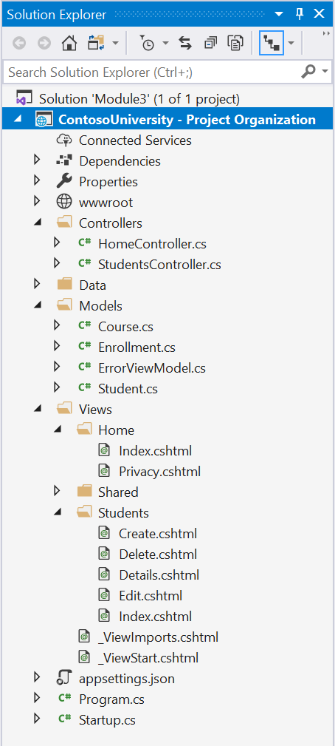
ASP.NET Core MVC Project File Organization
Much of ASP.NET Core MVC is “by convention”
Controller Conventions:
Reside in project’s Controllers folder
Suffixed by Controller (i.e. HomeController.cs)
Inherit from Microsoft.AspNetCore.Mvc.Controller
ASP.NET Core MVC does not require this structure
Convention over configuration
Default directory structure keeps application concerns clean
For example: Allows you to omit location paths when referencing views
By default, ASP.NET Core MVC looks for the View files in \Views\[ControllerName]\
Notes:
To the right is Screenshot of the Project Layout of a sample project.
Walk Thru the following parts (depending on previous coverage)
Controllers folder with two Controllers
Above that, WWWRoot folder which we have discussed previously
Models Folder, we have 4 different models
Views Folder. Notice that we have 2 views under Home and 5 Views under Students
Finally we have Program.cs and Startup.cs
<Most Important Point> Mention that much of .NET Core and MVC is by convention.
For example, the names of folders in your project are significant.
The names of Classes are significant
Controller Conventions are:
Inside Controllers Folder
Suffixed by Controller
Inherit from Controller
By default, ASP.NET Core looks for View Files under \Views\[ControllerName]. This will be important shortly when we look at some Controller Code
Technically MVC does not require this structure, you could put a Controller in any folder you want, but its best to follow convention for others who may work in your project/solution.
Screenshot taken from Demos\ContosoUniversity - Project Organization
Demo Project is from following steps in https://docs.microsoft.com/en-us/aspnet/core/data/ef-mvc/intro?view=aspnetcore-3.1
Technical Requirements for a Controller are: https://docs.microsoft.com/en-us/aspnet/core/mvc/controllers/actions?view=aspnetcore-3.1#what-is-a-controller

Slide 17
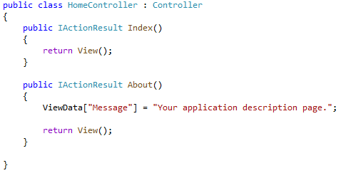
Controller Development
Notes:
Reminder: Controllers are classes and are used to define and group a set of actions.
Reminder: Actions are methods on a controller which handle requests.
Here is an example Controller Class
Notice that it is named HomeController
It inherits from Controller base class (Microsoft.AspNetCore.Mvc.Controller)
it resides inside our controllers folder
<Flip back to previous slide to show those points, and the file in the hierarchy>
Our Controller has two methods, and these methods are Actions.
How do we know they are Actions? We’ll talk a bit more in a bit, but for now, Actions are all public methods not marked with [NonAction] Attribute.
Our Two Actions: Index and About
Both return a View which inherits from IActionResult
We can see that the About Action sets some “ViewData”

Slide 18
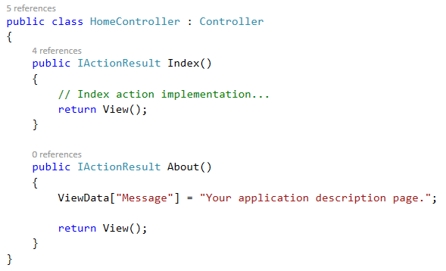
Executing Actions
http://contoso.com/<controllername>/<actionname>
http://contoso.com/home/Index
http://contoso.com/home/About
Notes:
We will cover routing more extensively later, but for now.
The path to a give Action is as follows: http://<hostname>/<controllername>/<actionname>
So to call our Index method, we’d used http://<hostname>/Home/Index
And if instead we called http://<hostname>/Home/About
This would execute our About method, placing this string in our ViewData object and then returning a View.
We will talk more about Views in our next module, but as mentioned two slides ago, this will seek out a view located in the folder
Views\Home\About.cshtml
<Consider flipping back 2 slides to show the file in the hierarchy>

Slide 19
Action Methods
Action (Action Method) are methods on a controller which handle requests
Controllers logically group similar actions or functionality together
Actions should contain logic for mapping a request to a business concern
Example:
http://contoso.com/Students/Create
Base URL
StudentsController
Create Action Method
Notes:
Reminder: Controllers logically group similar actions or functionality together
Reminder: Allows common set of rules, such as routing, caching and authorization to be applied collective
Actions should contain logic for mapping a request to a business concern.
Examples include
Our Home Controller,
we have Index Action to display the “default” screen related to “home”
we have About action to display the “About Us” screen.
Suppose we had a Student Controller for managing students of a University
We may have a Create Action for adding new Students to our University
We may have an Edit Action for modifying a Student
We may have List and Details Actions for displaying lists of students or detailed information about students.
In each of these examples, we are grouping similar functionality together into Controllers.

Slide 20
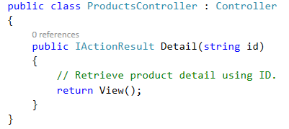
Action Method Parameters
Parameters on actions are bound to request data and are validated using “Model Binding”
Route Data via URL
Form Fields
Query Strings
URL: http://contoso.com/Products/Detail/5
Action Method:
Notes:
Parameters on actions are bound to request data and are validated using “Model Binding”
We will talk more about this in a bit, but data from our parameters may come from
URL i.e. http://<hostname>/student/details/<some student ID>
It may come from a Form on the page
Query String Values
Not an exclusive list, there are other sources, more on that later

Slide 21
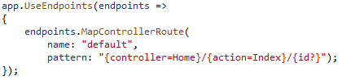
Default Routing
Default Routing Configuration in .NET Core MVC App
Route Name = default
Pattern: <controller>/<action>/<variable>
Home & Index are default values
Id? Is an optional segment which can be used for Parameter Binding.
Notes:
Here’s the configuration which sets up that previous mapping we saw.
This is configured inside Startup.cs inside the Configure method.
We have specified a Route “name” and then a “pattern”
The pattern indicates the format for what our routes should look like.
We have here controller <slash> action , <slash> a nullable variable called ID
As we saw in the previous slide, our action method took a parameter of ID, this route configuration is what defines that URL segment as a parameter available for Parameter Binding.
This will support any number of controllers and actions which conform to this pattern.
If we have additional needs with other parameters or patterns, we can add routes to this list.
We don’t want to get too deep into routing now, we have another module dedicated to it.
https://docs.microsoft.com/en-us/aspnet/core/fundamentals/routing?view=aspnetcore-3.1

Slide 22
Demo: Project Organization, Controllers, and Action Methods
Notes:
Demo Objective: In this demo, let’s explore a couple projects and see how Projects are organized in ASP.NET Core MVC, examine a few prebuilt controllers and their Action methods
Demo Script
First we will look inside a brand new MVC Project
Create a New ASP.NET Core Web Application Project (Preferred)
- Select Web Application (Model-View-Controller)
- Ensure Asp.NET Core 3.1 is selected
OR
- Open Project FileNewMVCProject from Demos\Module 03 – Controllers\FileNewMVCProject
Part 1 (Foundations of Controllers)
1) Expand the Controllers, Models and Views and Views/Home Folders
2) Reiterate some of the information from a few slides ago about what is in the different folders and their purpose
3) Open HomeController.cs. Discuss the 3 Action Methods Index, Privacy, and Error
4) Highlight that the Controller inherits from Controller. Go to the definition
5) Show that Controller provides a number of “Helper” methods such as View() and has objects such as TempData, ViewBag, and ViewData which we can interact with to send information to Views
6) Go to Definition on ControllerBase and show the objects related to HttpResponse and HttpRequest that we can interact with. Show all the additional “helper” methods we are inheriting.
7) It is important to understand that there is a large amount of inherited code here which explains the “Magic” that is MVC.
Part 2 (Action Methods & Simple Routes)
Run The Solution
Navigate between the Home and Privacy Pages.
Point out the difference in the URL at the top.
Manually enter /Home/Index to highlight the Default Route.
Return to Visual Studio and insert Breakpoints into the Constructor and Index(), Privacy(), and Error() Action methods
Demonstrate switching between Home and Privacy, showing Constructor running each time before the action methods.
Finally show the Error() Action method
Part 3 (Basic Parameter Route)
- Open Project ContosoUniversity - Project Organization from Demos\Module 03 – Controllers\ContosoUniversity - Project Organization
Expand Controllers and show StudentsController.cs
Expand Models to show Student.cs and Course.cs have been added
Expand Views\Students to show the 5 new Views
Run the application
Click Students. Discuss how this would use the “Default Route” or “Index” method
Click Details on one of the Students. Highlight the URL.
Change the URL to another valid number (i.e. 6)
Click Edit and observe the URL.
We’ve now covered 3 different Actions on the Student Controller. Index, Details, and Edit
Return to Visual Studio and Briefly show the 3 Action Methods.
Note: Don’t get into details of the functions, as we’ll return to this solution in our next demo.
Mention the Parameters for Details and Edit.
We will discuss parameters further later in this module.
Finally in the Edit Method, point out the 3 return statements (NotFound, and View). We will be talking about this next.

Slide 23
Module 3: Controllers
Section 2: Developing Controllers
Lesson: Action Methods Return Types
Notes:
Overview:
Let’s talk about some common Return Types of our Action Methods.

Slide 24
Action Methods Return Types
Action methods typically return instance of IActionResult or Task<IActionResult>
Its is valid to return anything from an action method, though there are some common types.
Instead of working directly with the Response object, Action Methods return an object that describes what the response should be.
Action methods are responsible for choosing what kind of response, the action result does the responding.
Notes:
Actions typically return some implementor of IActionResult or for async method, Task<IActionResult>
But Action methods can return Anything.
Instead of working directly with the Response object, MVC returns an object derived from the IActionResult class that describes what the response from our controller should be
This may be rendering a view or redirecting to another URL or action method.
When an Action Method returns an IActionResult, the ExecuteResult method of that interface is called which generates the actual result

Slide 25
Common IActionResult Classes - Content
ViewResult – Renders a view to the response
PartialViewResult – Renders a partial view to the response
ViewComponentResult – Renders a view component to the response
JsonResult – Returns JavaScript Object Notation (JSON) content to the response
ContentResult – Returns generic “Content” to the response
Notes:
Some common IActionResult classes which we may return from our Action Methods
ViewResult, PartialViewResult, and ViewComponentResult cause the associated object to render to the response.
View Results will be our most common and the one we’ve seen in previous examples. Will show more in a demo shortly.
ViewComponents are new to .NET Core, and we’ll talk about further in our Views module. If you’re already familiar with Partial views, the are like more powerful Partial Views.
JsonResult is a quick way to take an object and format it in JavaScript Object Notation (JSON)
Finally ContentResult is a general response type that can return any type of Content.
Good documentation about various Action Results:
https://docs.microsoft.com/en-us/dotnet/api/microsoft.aspnetcore.mvc.iactionresult?view=aspnetcore-3.1
https://exceptionnotfound.net/asp-net-core-demystified-action-results/
https://hamidmosalla.com/2017/03/29/asp-net-core-action-results-explained/

Slide 26
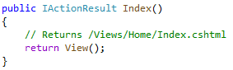
ViewResult Example
ViewResult
The View() method is inside the Controller base class
Creates a Microsoft.AspNetCore.Mvc.ViewResult object that renders a view to the response.
The View() method is smart enough to pick the correct view based on the Controller Name & Action Name.
/Views/<controllername>/<actionname>.cshtml
Notes:
A few examples:
View Result, we see that we are calling return View()
This is nothing more than a method from the Controller base class which create the appropriate ViewResult and returns it.
The appropriate ViewResults is inferred from the Controller Name and the Action Name.
In our case, our Controller Home and the Action Index produces /Views/Home/Index.cshtml
This is by far the most common and important IActionResult we’ll talk about and you’ll use.
There’s more complexity to this, for example passing data and parameters to Views, but we’ll discuss more of that in our next Module.

Slide 27
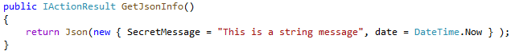
JsonResult Example
JsonResult
http://contoso.com/home/GetJsonInfo
{"secretMessage":"This is a string message","date":"2020-03-16T16:12:31.9953009-05:00"}
Notes:
JsonResult is very simple, returns JavaScript Object Notation of our object
Notice we are calling return Json
Creates a Microsoft.AspNetCore.Mvc.JsonResult object that serializes the specified data object to JSON.
Out output will look like this.
{"secretMessage":"This is a string message","date":"2020-03-16T16:12:31.9953009-05:00"}

Slide 28
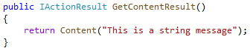
ContentResult Example
ContentResult
http://contoso.com/home/GetContentResult
This is a string message
Notes:
Even Simpler, we have Content Result which in this case we are just returning a string.
Creates a Microsoft.AspNetCore.Mvc.ContentResult object by specifying a content string.
We also have the capability of passing in MimeTypes and Encodings to customize what is returned further.
For most of our purposes in this class, we will be more concerned with the View-Type Results.

Slide 29
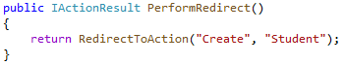
Common IActionResult Classes – Redirection Results
These return to the client a redirection response to an action or other destination.
RedirectResult – Redirect client to the provided URL
RedirectToRouteResult – Redirects client based on a registered route.
RedirectToActionResult – Redirects client to a particular action and controller in the same application.
Notes:
Redirection results can be used to redirect the client to another action or URL.
RedirectResult can be used to specify an exact URL, and this is useful when redirecting to URLs OUTSIDE our application, but for the purposes of MVC, its more elegant to use options such as
RedirectToActionResult OR RedirectToRouteResult
RedirectToActionResult for example allows you to specify a Controller name and Action.
The base class methods will determine the URL automatically for redirection.
In our example here, we see an Action named PerformRedirect which will return a RedirectToActionResult for the controller Student, Action Create.
Maybe you know the url will be /Student/Create, this automatically can determine how to format it for us.
RedirectToAction is more elegant way to redirect versus hardcoding a URL.

Slide 30
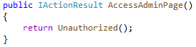
Common IActionResult Classes – HTTP Status Code
These result in an empty response body and return a specific Status Code.
BadRequestResult – Status Code 400
ConflictResult – Status Code 409
NoContentResult – Status Code 204
NotFoundResult – Status Code 404
UnauthorizedResult – Status Code 401
Notes:
HTTP Status results simply return an empty body with a specific Status Code.
We have a number of different ones which represent different status codes.
Our example here returns the result of calling Unauthorized.
Unauthorized() we inherited from ControllerBase and simply “Creates an UnauthorizedResult that produces an Status401Unauthorized response.
These are more specialized ActionResults, but there’s lots of built in methods to help you create what you want to return from Action Methods.

Slide 31
Demo: Action Method Return Types
Notes:
Demo Objective: Now let's return to our previous project and look at a few of the return types of Students Controller.
- Open Project ContosoUniversity - Project Organization from Demos\Module 03 – Controllers\ContosoUniversity - Project Organization
NOTE: Hopefully its only been a short while since you showed the previous demo, so very little refresh should be required.
Part 1 – Basic ViewResult Return Types
Begin with the HomeController.cs. Highlight the 3 Action methods and show they each are returning IActionResult
Note that for Index & Privacy, both just return View, while Error also passes a ViewModel.
Try not to get too deep into explaining Views during this section.
Reiterate that each call to View() is smart enough to take the name of the Controller, the name of the Action and return the file from /Views/<Controller>/<Privacy>
The Error View is special and is located under the Shared folder, which will be discussed in more detail in the next module.
Finally Right Click -> Go To Definition on View() to show the method signature inside the Controller base class.
Expand the comments to display the Summary & Returns comments
Part 2 – A More Complex Action Method – Details
Open StudentController.cs and Find the Details method.
Observe there are 3 different return statements. The first two are our “Status Code Type” and return 404 “not found”.
The final one returns a View.
Walk thru the code in detail to explain its entirety.
Highlight that we are creating a Student object.
Show the Student.cs class under Models\Student. This should be familiar from our previous module.
Finally discuss how we are passing the student to the View where the View handles displaying that data to the user.
Place a BreakPoint on the return View(student) and run the solution
Show the details of the Students about to pass to return View(). Then resume to show those details in the browser.
Part 3 – Setup for next Section
With the application running, click Students at top to bring back the List View
Select Create New
Enter in a LastName, FirstName, and Enrollment Date and click Create.
You may notice that we’ve been redirect to the Default Page (Index)
Show the newly added student in the list.
Return to Visual Studio, inside HomeController.cs find the CreateMethod
We only want to highlight a few topics we will be discussing in more detail shortly
Point out the Student parameter that is passed.
Discuss the code in detail.
If ModelState.isValid is false, what View is returned?? Answer: Create View
If ModelState.isValid is true? We save the new student and another Return Type: RedirectToAction(index)
Next up, we are going to talk about Model Binding and parameter passing.

Slide 32
Module 3: Controllers
Section 2: Developing Controllers
Lesson: Using Parameters and Model Binding
Notes:
Overview:
Now we want to talk about passing parameters to our Action Methods
https://docs.microsoft.com/en-us/aspnet/core/mvc/models/model-binding?view=aspnetcore-3.1

Slide 33
Action Method Parameters
Parameters on actions are bound to request data and are validated using “Model Binding”
Route Data via URL
Form Fields
Query Strings
URL: http://contoso.com/Products/Detail/5
Action Method:
Notes:
<instructor note> This slide is intended to tie in the previous conversation into Parameters & Model Binding
We had this slide before, where we saw that we can use our URL to pass parameters to our action method.
In this case, we have a controller Products, Action Method Details, and we pass the value 5 to Action method.
But this data can come from other locations such as Query String or as we saw in our last demo, Form Fields.
Let’s talk about “Model Binding”

Slide 34
What is Model Binding?
Controllers and Action Methods work with data that come from HTTP Requests
For example, we maybe have a StudentID come from the URL, but a Form Field may provide an updated Last Name for our student.
Writing code to retrieve values from the various locations and convert to the correct .NET Types can be tedious and error prone.
Model Binding automates this process for us.
Notes:
Controllers and Action methods work with data from HTTP Requests
(From Demo) In our examples, we saw requesting Student Details by providing an ID, or
(From Demo) Creating a new Student by passing in FirstName, LastName, and an Enrollmentdate
We didn’t have to write any special code to receive that StudentID or those Strings & Dates. In fact, if you were watching very closely, you may have saw our Action method was even passed a Student object.
Model Binding help automate the handling of mapping submitted data, whether from one of many different sources, to the parameters defined in our Action Methods.
https://docs.microsoft.com/en-us/aspnet/core/mvc/models/model-binding?view=aspnetcore-3.1#what-is-model-binding

Slide 35
What is Model Binding?
Retrieves data from various sources such as route data, form fields, and query strings
Provides the data to controllers and Razor pages in method parameters and public properties
Converts string data to .NET types
Updates properties of complex types
Notes:
Retrieves data from various sources such as route data, form fields, and query strings
By RouteData, we mean from the URL like we saw previously
Provides the data to controllers and as method parameters
Model Binding also can set public properties
Converts string data to .NET types
For example, when a date comes across the wire, its probably just a string representation of that date, but Model Binding will automatically convert to types like DateTime
Updates properties of complex types
Complex Types like our project defined Students class which consists of FirstName,LastName,Enrollment date and other fields.
https://docs.microsoft.com/en-us/aspnet/core/mvc/models/model-binding?view=aspnetcore-3.1#what-is-model-binding

Slide 36
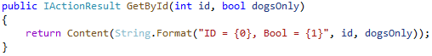
Simple Model Binding Example
https://contoso.com/Home/GetById/2?DogsOnly=true
Steps Taken:
Finds the first parameter of method GetByID, an integer named id.
Looks through the available sources in the HTTP request and finds id = "2" in route data (URL).
Converts the string "2" into integer 2.
Finds the next parameter of GetByID, a boolean named dogsOnly.
Looks through the sources and finds "DogsOnly=true" in the query string. Name matching is not case-sensitive.
Converts the string "true" into boolean true.
Notes:
Suppose we have this Action Method inside our Home Controller.
ActionMethod GetByID
Two Parameters
Integer ID
Boolean “DogsOnly”
Then we made the above HTTP Request
Model Binding would go thru the following steps
Read thru each step
https://docs.microsoft.com/en-us/aspnet/core/mvc/models/model-binding?view=aspnetcore-3.1#example

Slide 37
No Source for Property
If no valid value is found for a parameter or property, the property is set to null or default value
This will be more important when we talk about Complex Types, but for our simple example
https://contoso.com/Home/GetById/Five?DogsOnly=true
https://contoso.com/Home/GetById/1?DogsLonely=true
https://contoso.com/Home/GetById/1?DogsOnly=1
Notes:
If we do not have a valid value for a parameter or property, the property is set to null or the default value for that type.
This is even more important during Complex Types, but we want to talk about it now
Here is our same method from before
Consider the following three requests which are all slightly different
The first,
we don’t have an Integer; we instead have the word five.
This behavior is the same as if we put any string text here that isn’t a number, its not a valid integer
Therefore, ID = 0, Bool = True
If you don’t know the default values of something there is a default(type) operator which will tell you, but it may just be easier to do an internet search
The Second Example
We now have changed the Query string to DogsLonely
If you recall from our process on the previous page model binding starts with the parameter (dogsOnly) and goes searching for data for it
Since there is none specified, it uses the default for bool, which is false
Therefore, ID = 1, Bool = False
Finally,
We have now changed DogsOnly=1. In many language non-zero integer values are equivalent to “true”. In this case though, Model Binding does not map it correctly
Therefore: ID = 1, Bool = False
https://docs.microsoft.com/en-us/dotnet/csharp/language-reference/builtin-types/default-values
https://docs.microsoft.com/en-us/aspnet/core/mvc/models/model-binding?view=aspnetcore-3.1#no-source-for-a-model-property

Slide 38
Model Binding Sources
Model binding gets data in the form of key-value pairs from the following:
Form Fields
Request Body
Route Data / URL
Query String Parameters
Uploaded Files
List is scanned in order
Can use Attributes such as [FromQuery] or [FromForm] specify a specific source.
Notes:
We’ve seen already how we can use Routing Data or URL and Query String data for parameters.
Here we have a list of locations which are scanned in order for each parameter/type that is required for our Action method.
Request Body here is specific to APIController, and Uploaded Files is a bit of a special case. Our primary 3 are “Form Fields”, RouteData/URL and Query String Parameters
As mentioned, these are evaluated in order, first found entry wins.
The story of customizing how Model Sourcing goes much deeper, far deeper than we’re able to cover in this course.
Some examples of easy customizations
We can add attributes to specify a specific source.
For Example, maybe I want a parameter to only come from the QueryString. Based on the ordering above, if by chance there is a Form Field name which matches, it would use that first since the list is processed in order.
Discuss Sources: https://docs.microsoft.com/en-us/aspnet/core/mvc/models/model-binding?view=aspnetcore-3.1#sources
Discuss Complex Types

Slide 39
Model Binding – Simple Types
Boolean
Byte, SByte
Char
DateTime
DateTimeOffset
Decimal
Double
Enum
Guid
Int16, Int32, Int64
Single
TimeSpan
UInt16, UInt32, UInt64
Uri
Version
Notes:
Here is a list of simple types that Model Binding can convert source strings into.
We’ve already seen a few of these in action where we had a query string which read:
DogsOnly=True and Model Binding took the string “True” and convert it to a Boolean variable.
But what about if we have complex types? We want our ActionMethod to accept a “Student” object instead of two strings, and int and a DateTime.
<slide>
https://docs.microsoft.com/en-us/aspnet/core/mvc/models/model-binding?view=aspnetcore-3.1#simple-types

Slide 40
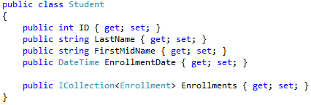
Model Binding – Complex Types
A Complex Type Example:
Notes:
Suppose we had a Model named Student which consists of an ID, FirstName, LastName, and a DateTime Enrollment Date
We then have a Controller for Students with a Create ActionMethod.
How does Model Binding handle this scenario with a Complex Type?
<slide>

Slide 41
Model Binding - Complex Types
Complex Types must have:
A public default constructor
Public writeable properties
The model binding engines:
Instantiates an instance of the class using public default constructor
Searches for each property using the Model Binding Sources List
Sources:
Prefix.property_name
Prefix = Name of the Parameter, NOT name of the Class
E.g. StudentToCreate, NOT Student
Property_name
Notes:
Complex Types have the following two requirements to be used in Model Binding.
Must have a public default constructor
Must have Public Writeable properties for the properties you want to bind to.
When the engine is preparing to call your ActionMethod, it will create a new instance of the model class using the public default constructor
Then will begin trying to populate each property
It will first search for “Prefix.property_name”.
The prefix is the name of the parameter. Its important to note that this is NOT the name of the class.
<flip back to previous slide>
Notice that the parameter name is studentToCreate. This means we will search for:
studentToCreate.ID or studentToCreate.LastName
Next, if it doesn’t find prefix.property_name, it will just look for any field that matches the property name, such as LastName.
The reason it binds to parameterName instead of className is incase we want to pass in two objects of the same time.
Perhaps we’d have studentOld and studentNew passed into a Compare Action method. These would look for studentOld_FirstName and studentNew_First name during databinding.
https://docs.microsoft.com/en-us/aspnet/core/mvc/models/model-binding?view=aspnetcore-3.1#complex-types

Slide 42
Model Binding – Complex Types Customizations
There are many attributes which can be applied to customize binding for Complex Types
[Bind(Prefix = “Estudiante”)] Student studentToCreate
[BindNever]
[BindRequired]
[Bind(“LastName, FirstMidName,EnrollmentDate”)]
Can be applied to Class or inside Method
Can be used to protect against overposting.
Notes:
There is a fair amount of customization that can be done to tweak how model binding occurs with Complex Types
For example, we can use Bind with a Prefix to change what the Prefix is for a particular parameter.
Without this Prefix setting, model binding would search for studentToCreate_LastName.
Instead, it will search for Estudiante_LastName.
Spanish word for Student
[BindNever] is applied to model properties and causes a public property to skip model binding
[BindRequired] also applied to model properties and causes an ERROR if binding does not succeed.
You might recall from earlier that if model binding does not succeed, it uses the default value for that type. This applies the same to types inside Complex Types.
If we don’t provide a LastName, Lastname will be equal to the default for string which is null.
[Bind] is very important, if you’re only going to remember one of these, remember Bind.
Bind allows us to specify what properties of a model should be included in model binding
We can specify this Attribute on the model itself or the action method parameters.
An example may be:
Our StudentID is to be automatically generated, so if we are running a Create Action Method, we would not want an ID submitted, so we would list only the properties we want to bind, excluding ID.
This is very important due to the concept of Overposting where a user maybe modifies the HTTP post or the webpage form and sends more data than the developer is expecting.
On your Create View, you maybe don’t have a field for ID, so the post should never include ID, right?
It is trivial for a user to modify their POST data and include an ID, and if Model Binding is not told otherwise, it will bind it to the property.

Slide 43
Model Binding – Model State
Model state represents errors from:
Model Binding
Model Validation
Model Binding & Model Validation occur before execution of Action Method
We can use ModelState.IsValid to check the results.
Can rerun validation using TryValidateModel
Notes:
As we will learn in a later module, Models can participate in Validation. There also may be errors that occur during Model binding due to data conversion errors.
ControllerBase provides an object called ModelState which contains the State of the Model and Model-Binding Validation
One of the most common operations is to check IF ModelState.IsValid
If the model is not valid, we obviously don’t want to save it.
An example may be if you pass an “X” into a FormField that is expecting an integer, that would fail Model Binding.
We’ll talk more about validation later, but an example of this may be if you have a field that expects a rating between 1 and 5, and the user enters 0.
https://docs.microsoft.com/en-us/aspnet/core/mvc/models/validation?view=aspnetcore-3.1

Slide 44
Demo: Model Binding
Notes:
Demo Objective: We return to our ContosoUniversity project to look at Model Binding.
- Open Project ContosoUniversity - Project Organization from Demos\Module 03 – Controllers\ContosoUniversity - Project Organization
NOTE: Hopefully its only been a short while since you showed the previous demo, so very little refresh should be required.
Part 1 – Basic Type
Begin in StudentsController.cs
Show Details(int? id) method signature.
We are expecting a nullable int named id.
Run the Solution
Click Students, then select Details next to one of the Students
Note the URL
We are using Routing/URL data to provide our parameter to our Action Method
Now change the URL to use the query string
https://localhost:44342/Students/Details?id=5
Notice the page updates by passing the ID into the Action Method.
Another Example
https://localhost:44342/Students/Details/3?id=6
What would happen for this? Would the Action method receive 3 or 6?
Answer: 3 because RoutingData/URL is taken before QueryString
In Visual Studio, set a breakpoint inside the Details Action method
https://localhost:44342/Students/Details/Admin
Notice we are no longer providing an value that can be converted to Int
As result, the application uses the default value of the type int? which is null.
Part 2 – Complex Types
Find the Create() Action Method
Discuss the parameters. Note that we have Bind specified and we’re looking to receive a student model.
Open the Student.cs class under models in order to show how it is defined.
Mention that “EnrollmentsCollection” will not participate in databinding because of the Bind Attribute on the create method.
Type out an example of adding a new Property such as GradePointAverage and labeling it with [BindNever] to indicate the application should never be binding submitted data for this property.
Place a Breakpoint in Create function, then go Create a new user.
Show in Watch Window that the student variable has been populated with the form values.
Finally point out the ModelState.isValid check. More on this during a later module.
Part 3 – Setup for next Section
Finally find DeleteConfirmed method.
Notice above it, there are several attributes specified [HttpPost, ActionName, and ValidateAntiForgeryToken].
In our next section, we’ll discuss Filters and other Attributes we may apply to ActionMethods & Controllers.

Slide 45
Module 3: Controllers
Section 2: Developing Controllers
Lesson: Action Filters and other Attributes
Notes:
Now let’s discuss Action Filters and other Attributes we may see when developing Controllers

Slide 46
Action Filters
Classes which apply Cross-Cutting Concerns to Controllers and Action Methods.
Examples
Authentication/Authorization
Caching
Exception Handling
Can be applied using Attributes to Controllers & Action Methods
Can also apply a global filter by adding into Startup.ConfigureServices
Notes:
Filters can be used to apply Cross-Cutting concerns to our MVC application on Controllers & Action Methods
A few examples Authentication & Authorization. Instead of our Action methods each checking to make sure we have a valid user, we can decorate it with a particular Attribute which enforces users to be authenticated before continuing.
We can also apply these Filters at the Controller level which applies the behaviour to all Action Methods
The concept of Cross-Cutting Concerns is that if we have behaviours or logic that must run before or after many or all Action Methods, we can use filters classes to encapsulate that behaviour
https://docs.microsoft.com/en-us/aspnet/core/mvc/controllers/actions?view=aspnetcore-3.1#cross-cutting-concerns

Slide 47
Filter Attributes
Filter Attribute | Description
[Authorize] | To restrict access to only those users that are authenticated and authorized
[Authorize(Roles="Admin")] | To restrict access only to users with Role “Admin”
[AllowAnonymous] | To allow anonymous users to call the action method
[RequireHttps] | To force an unsecured HTTP request to be resent over HTTPS
[ValidateAntiForgeryToken] | To prevent forgery of a request (Defense against CSRF attack)
Notes:
A few built-in Filter Attributes
[Authorize] will cause an Action Method to restrict only to Authenticated Users
If Instead we include (Roles = “Admin” the Authorize Filter knows to prevent all users not in the Admin Role
Note: We will talk more about these parts in a later module, so we don’t want to get into too much detail.
[AllowAnonymous] is a Filter Attribute which allows us to specifically say that Anonymous Requests can call a particular method.
This works well if you mark a Controller with [Authorize] it will restrict to only authenticated users
With AllowAnonymous on an ActionMethod, it relaxes that restriction on a particular method.
RequireHTTP requires HTTPS for a particular request. Ideally we’d use HTTPS for our entire application, but if not, perhaps we lock down specific Methods to require HTTPS
Finally ValidateAntiForgeryToken is an essential tool in preventing Cross Site Scripting.
For the complete listing of filter attributes, see in the Inheritance Hierarchy section in the following web page:
https://msdn.microsoft.com/en-us/library/system.web.mvc.filterattribute(v=vs.118).aspx

Slide 48
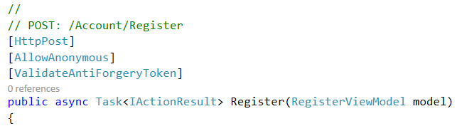
Action Filter Example
Below are Two Action Filters: AllowAnonymous and ValidateAntiForgeryToken
HttpPost is a “Selector Attribute” and we will discuss it shortly.
Account Controller - Register Method
Notes:
Here we see an Action method which has two Action Filters.
AllowAnonymous and ValidateAntiForgery.
You may also notice HttpPost, but that is technically not an Action Filter, but we’ll discuss it shortly.
Because we have these two Action Filters, logic related to those two will be executed whenever we have a call to the Register Action Method
Let’s look at what that flow looks like
<slide>

Slide 49

Actions with Filters
User Request
MVC Instantiates Controller
Pre-Execution Filter Code Executes
Action is Executed
HTML Returned
Model is Combined with View
Post-Execution Filter Code Executes
Notes:
- Here is the generally flow of Action Filters with regard to an MVC Request.
- We see there is pre-Execution Filter code and Post-Execution Filter Code.
After the Controller is created and our action has been selected, we execute any relevant Pre-Execution Action Filter Code
Its important to note that our Filter maybe short cuts our request and the Action never executes
For example, if we have Authorize Filter on a method and we are not Authenticated, we will not continue executing the method and return an UnAuthorized response.
Filters are able to execute code AFTER an Action method as well. This is especially useful for Caching Scenarios, Logging, or ExceptionHandling.

Slide 50
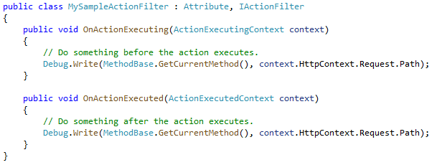
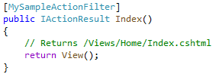
Custom Filters
Its relatively easy to create your own filters
Notes:
Its relatively easy to create your own Custom Filters.
We have here MySampleActionFilter which inherits from IActionFilter and Attribute
Define two methods. One runs before the Action Executes and one After
Then we see the Filter applies to an Index Action Method.
Recommend students find some time to implement their own Action Filters to solidify their understanding of the subject.
https://docs.microsoft.com/en-us/aspnet/core/mvc/controllers/filters?view=aspnetcore-3.1#action-filters

Slide 51
Selector Attributes
Selector Attribute | Description
[NonAction] | To mark a method as non-action
[HttpPost] | To restrict a method to handling only HTTP POST requests
[HttpPut] | To restrict a method to handling only HTTP PUT requests
[HttpGet] | To restrict a method to handling only HTTP GET requests
[AcceptVerbs] | Specifies which HTTP verbs an action method will respond to
… | …
Notes:
Finally we want to mention “Selectors”.
This term is a bit antiquated and we don’t call them Selectors anymore.
Like filters, these are Attributes and are applied to Action Methods
But they are used for routing and Action Method selection.
NonAction marks a method as not an action. As result, it won’t be callable from a URL.
As we mentioned before, all Public Methods on a Controller are considered actions. NonAction lets us mark Public Methods as non-actions
HttpPost, HttpPut, and HttpGet are called HttpMethodAttributes are used in selecting the correct Action method based on the incoming request.
If we are performing a GET request on CreateStudent, then it is assumed we are simply requesting the form to Create a Student.
If we are performing a POST request on CreateStudent, then we are posting form data back to the Controller to create an actual student.
We can annotate our functions with these Attributes and MVC will automatically select one versus the other based on the HTTP Method of the Request.
AcceptVerbs is another way to apply these HTTP Methods, but we maybe want a particular method to execute for POST and PUT, so we can use AcceptVerbs and a list of Verbs to select that method.
This subject will be covered more during the module on Routing.
https://docs.microsoft.com/en-us/aspnet/core/mvc/controllers/routing?view=aspnetcore-3.1#attribute-routing-with-httpverb-attributes

Slide 52
Demo: Filters
Notes:
Demo Objective: We have a simple web application which mostly allows anonymous access to the site. We would like to protect a few areas requiring the user to be simply Authenticated in order to access to functions. We will accomplish this by applying the Authorize Filter to an Action Method and then an entire Controller.
Demo Script:
Open Project FiltersDemo from Demos\Module 03 – Controllers\ActionFilterDemo
This project was File-New MVC Application, but we configured to use “Individual Accounts” for authentication. This just gives us template Login/Register pages and will be covered in more detail later in the course.
Run the Application
Quickly run thru each of the items in heading: Home, Privacy, ContactUs, WorkHome, and WorkPrivacy
Point out URL how it indicates the first 3 are in handled by the Home Controller and last two are handled by WorkController.
Stop the Application and open HomeController.cs
Highlight the three Action Methods: Index, Privacy, and ContactUs
We want to ensure that only people Authenticated users use the ContactUs functionality.
Add using Microsoft.AspNetCore.Authorization;
Add [Authorize] above the ContactUs method
Using intellisense show [Authorize( options. Point out that we have the ability to do granular rules like only allowing based on a particular role. Again more on this later
Run the Application and navigate to ContactUs.
Notice that it automatically redirects us to the Login Page.
The Authorize Filter hooks until the Authetication/Authorization system and redirects user accordingly.
Before Closing the application, show that Work Links still work without Authenticating and that they are handled by Work Controller
Stop the Application and open WorkController
Add [Authorize] above WorkController
This now will require ‘Authorize’ for all action methods.
Run the Application and show that WorkHome and WorkPrivacy both redirect to login.
Finally show code in Startup.cs for adding global filter. Search for MySampleActionFilter to show commented out Filter.
Other Action Filter Examples: https://docs.microsoft.com/en-us/aspnet/core/mvc/controllers/filters?view=aspnetcore-3.1#action-filters

Slide 53
Module 3: Controllers
Section 3: Dependency Injection (DI)
Lesson: Overview
Notes:
Now let’s discuss Dependency Injection which is very important concept related to developing concise, testable Controllers.

Slide 54
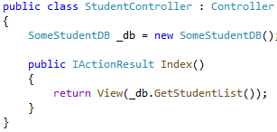
Dependency Injection
Dependency Injection is a technique for achieving Inversion of Control between classes and their dependencies
Dependency: Any object that another object requires
Example: StudentController may depend on a data store for loading/saving Students.
Notes:
Dependency Injection is a technique for achieving “Inversion of Control” between classes and their dependencies
What is a Dependency? Its any object that another object requires.
The classic way of developing classes is for each class to create their own dependencies.
In our example, we have a Student Controller that requires some database which contains students.
We see here, that we are directly creating the object inside our class
What are the problems with this?

Slide 55
Dependency Injection – Issues with example
We must modify our StudentController if we want to use a different implementation
If our dependency has its own dependencies, they must be configured by StudentController.
This can have a large cascading effect
Imagine a logging component that logs to a database
This model is very difficult to unit test.
We may need to use mock or stub classes to replace our dependency
Notes:
If we wish to use a different implementation of our StudentDatabase, we need to modify our StudentController class.
Our Student Depemdency has its own dependencies, then our StudentController must know how to configure them.
This can get messy quickly with large projects.
Imaging you have some Logging dependency you want to create, that logging dependency may depend on a Database Context.
You’ll need to configure both
One of the biggest problems, Unit Testing our Controller is really difficult as we can’t swap in stub or mock classes for our dependencies.

Slide 56
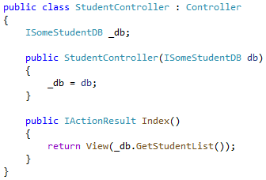
Dependency Injection
Use of Interface to abstract dependency
Injection of the dependency into controller’s constructor.
Notes:
Here’s an example of converting a Controller to utilize Dependency Injection
Notice we have changed our variable to use an Interface (ISomeStudentDB) instead of the concrete class.
We also have a new constructor which accepts an object of type ISomeStudentDB.
So our Controller now requires a “StudentDB” object to be passed to it when its created.
But you may recall that we are not manually creating our Controllers, they are created by the Controller Factory.
Let’s consider our issues from the previous slide:
Changing implementation of SomeStudentDB will not require changes to StudentController unless we change the interface.
This means if we have a SQL StudentDB vs a File Based vs an InMemory Student DB, Student Conroller doesn’t have to change.
On the last point about Unit Testing, we can easily provide a different implementation of ISomeStudentDB as we just mentioned.
The third concern we talked about was chained dependencies where our class would need to know how create and configure all its dependencies and then any dependencies they depend on.
This is no longer a concern as our Class doesn’t know how to create or configure its dependencies, it is just assumed we are given a build implementation that has everything it needs.

Slide 57
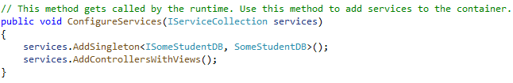
Dependency Injection – Registering Dependencies
Dependencies are registered during application startup in Startup.cs method named ConfigureServices
Notes:
The last piece of this puzzle is how we actually register our Dependencies.
.NET Core has Dependency Injection built in to it and allows us to quickly and easy register our dependencies during application Startup, and use them in our Controllers and Views.
MVC handles the lookups for us to determine what to pass into our Controller’s constructors
Above we see the ConfigureServices method of Startup.cs.
You see we are registered with services a Singleton. We provide our Interface and our Concrete class.
This will create a single instance of SomeStudentDB and whenever Dependency Injection requests an “ISomeStudentDB” it will inject that instance.
There are other options for Service Lifetimes than Singleton, we will talk about those later.
You’ll notice there’s also a call to services.AddControllersWithViews(). There’s a ton of logic behind that call, but some of it is adding services just like we’re doing here.
Now imagine we want to change an implementation of SomeStudentDB for a test environment. We would just need to change this first line here.
If we want to perform unit tests on a Controller that depends on ISomeStudentDB, we can simply create that controller by itself, passing some MOCK or Stub instance of that interface.
So the complete picture is:
We registered our dependencies & services during Application Startup
We declaratively state in our Controllers what our dependencies are.
At Runtime, the Controller Factory, after it has selected our Controller, goes searching thru the registered dependencies for ones that match the Controller’s parameters.

Slide 58
Without Dependency Injection (DI)
Tightly Coupled - Component determines which implementation to use
File System Vehicle Locator
IVehicleLocatorService service;
switch(config.Locator)
{
case VehicleLocator.FileSystem:
{
service = new FileSystemLocator();
break;
}
case VehicleLocator.Database:
{
service = new DatabaseVehicleLocator();
break;
}
}
Component
IVehicleLocatorService
Database Vehicle Locator
Notes:
Optional Slide
DI is a design pattern which removes the responsibility of a component to know how to locate and create an instance of a dependent service.

Slide 59
What’s the Problem? (Part 1)
Redeploy of new service that is tightly coupled means Component also needs to be rebuilt, retested, and redeployed
Both components will be shipped/deployed, whereas only one may be required for the production environment
File System Vehicle Locator
v2
Component
IVehicleLocatorService
Database Vehicle Locator
Notes:
Optional Slide

Slide 60
What’s the Problem? (Part 2)
Unit testing should be proving Component in isolation, and not rely on external resources such as databases or file systems
Need to add a mechanism to Component to use the Mock implementation during unit testing – this will also introduce a dependency on the mock service
File System Vehicle Locator
v2
Component
IVehicleLocatorService
Database Vehicle Locator
Mock Vehicle Locator
Notes:
Optional Slide

Slide 61
Inversion of Control
DI is a design pattern which removes the responsibility of a component to know how to locate and create an instance of a dependent service
File System Vehicle Locator
v2
2
Component
IVehicleLocatorService
Database Vehicle Locator
3
Dependency Resolver
IoC Container
Mock Vehicle Locator
RegisterType<IVehicleLocatorService>(…)
1
Notes:
Optional Slide
1 – Class types are associated with an interface for that service type and registered with the IoC Container
2 – At the time of the component’s construction, the framework will look to the dependency resolver to satisfy instances.
3 – The Resolver looks for the most appropriate class to create or instance to return to satisfy the dependency.
Note that (1) may be (and is typically done) in the configuration files rather than hardcoded in an application, such that the component is not tightly coupled to the dependent service directly at the build time.

Slide 62
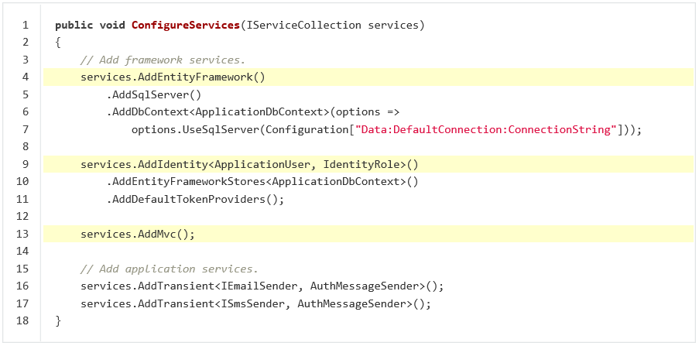
Framework – Provided DI in ASP.NET Core
DI is provided by ASP.NET Core, and is used to resolve Controllers as well as services
Framework services are set up in the ConfigureServices function in ASP.NET Core
Your own services can also be registered here – specifying Interface, Class, and Lifetime
Notes:
Here we can see a slightly more complex scenario where we are registering several services.
At the bottom, notice we are registering two Application Services, for sending Emails and SMS Messages.
In our Controller, we’d have in our constructor ISmsSender or IEmailSender and it either would resolve to an instance of AuthMessageSender
We have services.AddMvc() which does a ton of work adding services necessary for running MVC applications. Remember ASP.NET Core is open source, so we can go look at what all that is doing if we’d like.
Back at the top, we are adding EntityFramework. This is registering a service of type ApplicationDbContext such that we can request an ApplicationDbContext in our Controllers and use that for each method that needs it.
Here’s an example of how we are passing some configuration to the registration to provide our Context with a connection string.
Next service registered is AddIdentity which is configuring some Identity Services that we’ll talk about in a later module. Notice we are passing in an ApplicationDbContext type which means that AddIdentity will have a dependency on that.
It is worth noting that the Services Container is meant to serve the basic needs of the framework and most consumer applications are built on it. However, developers who wish to replace the built-in container with their preferred container can easily do so. The ConfigureServices method typically returns void, but if its signature is changed to return IServiceProvider, a different container can be configured and returned. There are many IOC containers available for .NET such as 3rd party containers: Autofac, Stashbox, Unity and many more.
https://docs.microsoft.com/en-us/aspnet/core/fundamentals/dependency-injection?view=aspnetcore-3.1#default-service-container-replacement

Slide 63
Service Lifetimes and Registration Options
Transient
Transient lifetime services are created each time they are requested. This lifetime works best for lightweight, stateless service
Scoped
Scoped lifetime services are created once per request
Singleton
Instance
Singleton lifetime services are created the first time they are requested, and then every subsequent request will use the same instance. If your application requires singleton behaviour, allowing the services container to manage the service’s lifetime is recommended instead of implementing the singleton design pattern and managing your object’s lifetime in the class yourself
Similar to Singleton, but the instance is created when added to the services container and reused throughout, whereas with a Singleton the instance is first created only when first requested for use
Notes:
There are several different “lifetimes” that can be used when registering services. This determines if services should be created fresh for each instance required, or if only one should be used for all requests and users.
The easiest to understand is Singleton (3rd on the list)
The first time a Singleton Service is requested, the system will create one, and that is the instance that is used until the application shuts down. There will be only a Single Instance of it for the entire application.
Maybe you have a randomizer service that should be shared
Last on the list is Instance. This just like Singleton, but is instead created when the service is added to the services container, instead of when first created.
Imagine you have some controller that uses a Weather Service. The difference with this lifetime is the service is created at app startup as opposed to the first time you call the Controller
Transient at the top: Every time a service is requested, it creates a new one. This makes sense for small stateless services
Finally Scoped, which are smart enough to create a new one for each HTTP request. This is what EntityFramework registers as. For each individual request, we create a new instances, and throw it away at the end of a request.

Slide 64
Other Dependency Injection
Services can be registered against Interface, Base Class or Concrete Class
Services can be injected directly into an Action Method using [FromServices]
Views are able to have services injected to them using @inject
Think of @inject as adding a property to the view
Services.TryAdd{Lifetime} e.g. Services.TryAddSingleton< … > will only register a dependency if there is not already a registered implementation.
Dependency Injection allows us to focus on developing Controllers & Views without concern for constructing dependencies.
Notes:
Services can be registered against Interface, Base Class or Concrete Class
Controller Factory looks at Controller Constructor for the type listed and looks for a match registered service.
We can inject services into ActionMethods using an Attribute [FromServices] in the arguments.
This is very useful when a single method requires a service as opposed to an entire controller.
We can use DI only for that method instead of passing it into the constructor
Views can use Dependency Injection and we can pass Services into a View
This is using the @inject keyword
This will be discussed more in our next module.
Normally we add Services using AddSingleton or AddScoped. We also have TryAddSingleton and TryAdd any lifetime.
This only registers a dependency if there hasn’t already been one of that same type.
This is useful for library authors to avoid registering two copies of an instance in the container.
Dependency Injection allows us to focus on developing Controllers & Views without concern for constructing dependencies.

Slide 65
Demo: Dependency Injection
Notes:
Demo Script:
Run the application from Demos\Module 03 - Controllers\DILifetimesDemo and demonstrate various service lifetimes.
General ideas:
Show that DI is first class citizen of new ASP.NET Core framework.
You could reduce memory consumption (load on garbage collector and memory allocator).
To cache an object in DI container and extract it for every request rather than re-creating it.
In OperationController, constructor defined dependencies from 4 different services. Each of them will be extracted from serviceCollection and injected in a constructor.
Controller is the type that will be recreated with each user request, but dependencies could have separate lifetime. If you need 1 instance of an object during application worktime - you could use Singleton or Instance.
Let’s use EntityFramework datacontext as an example of scoped lifetime. If 2 services are dependencies of 1 controller and both of them needs datacontext, we could add him as Scoped and as a result 1 instance of datacontext class will be referenced.
Transient (Transient lifetime services are created each time they are requested. This lifetime works best for lightweight, stateless service )
Scoped (Scoped lifetime services are created once per request )
Singleton (Singleton lifetime services are created the first time they are requested, and then every subsequent request will use the same instance. If your application requires singleton behavior, allowing the services container to manage the service’s lifetime is recommended instead of implementing the singleton design pattern and managing your object’s lifetime in the class yourself )
Instance (Similar to Singleton, but the instance is created when added to the services container and reused throughout, whereas with a Singleton the instance is first created only when first requested for use)

Slide 66
Module 3: Controllers
Section 4: Advanced Topics
Lesson: Areas

Slide 67
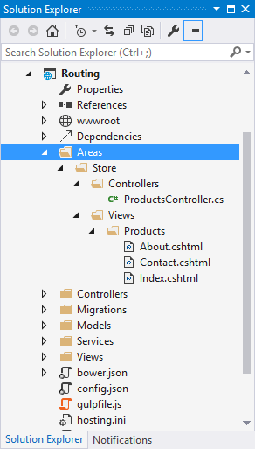
Areas
MVC Areas separate a large MVC application into smaller functional groupings
For example: large e-commerce site divided into areas for storefront, product reviews, user accounts, etc.
Area Guidelines
Areas directory must exist as a project child directory
Areas contains subdirectory for each area
Controllers should be located at: /Areas/[area]/Controllers/[controller].cs
Views should be located at: /Areas/[area]/Views/[controller]/[action].cshtml
Notes:
Some applications can have a large number of controllers, and each controller can be associated with several views. For these types of applications, the default ASP.NET MVC project structure can become unwieldy.
To accommodate large projects, ASP.NET MVC lets you partition Web applications into smaller units that are referred to as areas. Areas provide a way to separate a large MVC Web application into smaller functional groupings. An area is effectively an MVC structure inside an application. An application could contain several MVC structures (areas).
For example, a single large e-commerce application might be divided into areas that represent the storefront, product reviews, user account administration, and the purchasing system. Each area represents a separate function of the overall application.

Slide 68
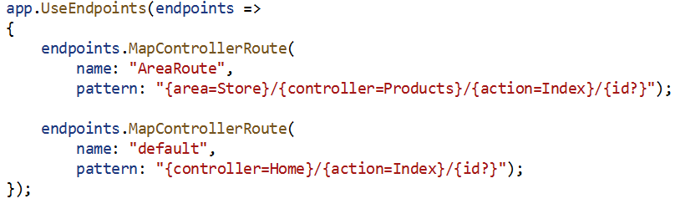
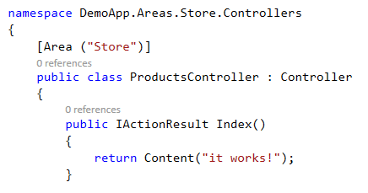
Area Registration and Linking
Area Registration
Startup.cs
~/Areas/Store/Controllers/ProductController.cshtml
Notes:
Note that in the example above, the default route would never be matched, since the area has default values for each parameter.

Slide 69
Demo: Areas
Notes:
Only do this demo if asked about Areas.
Demo Script not updated for .NET Core 3.1.
https://docs.microsoft.com/en-us/aspnet/core/mvc/controllers/areas?view=aspnetcore-3.1
Demo (Review Before Presenting)
https://github.com/dotnet/AspNetCore.Docs/tree/master/aspnetcore/mvc/controllers/areas/31samples/MVCareas

Slide 70
Module 3: Controllers
Section 4: Advanced Topics
Lesson: Async Controller Actions
Notes:
Overview:
Asynchronous Controller Action Methods

Slide 71
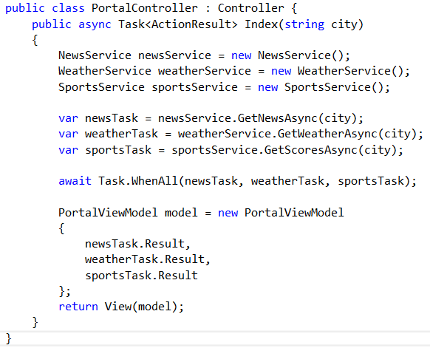
Asynchronous Controller Action Methods
ASP.NET MVC supports asynchronous action methods
Notes:
More typically used for WebAPI controllers, we can configure Action Methods to run asynchronously.
The goal of async actions is that if a thread becomes idle, then the thread can potentially be released to the pool to do other work
Above we have an Async Index Action method. Which depends on 3 different services. News, Weather, and Sports Task
Each of these have calls which we perform asynchronously. This means that each of these calls will return without waiting for the response.
Instead it is not until the Task.WhenAll is called that we wait for all 3 to return.
Docs to help with Async:
https://docs.microsoft.com/en-us/aspnet/core/web-api/action-return-types?view=aspnetcore-3.1
https://docs.microsoft.com/en-us/aspnet/core/performance/performance-best-practices?view=aspnetcore-3.1
Comments on this:
https://stackoverflow.com/questions/48015096/not-much-difference-between-asp-net-core-sync-and-async-controller-actions

Slide 72
Sync vs. Async Action Methods
Use synchronous methods when:
The operations are simple or short-running
Simplicity is more important than efficiency
The operations are primarily CPU operations instead of operations that involve extensive disk or network overhead
Use asynchronous methods when:
You are calling services
The operations are network-bound or I/O-bound instead of CPU-bound
Parallelism is more important than simplicity of code
Enabling cancelation of a long-running request
Notes:
Some guidance to know when to use Sync vs Async methods
Docs to help with Async:
https://docs.microsoft.com/en-us/aspnet/core/web-api/action-return-types?view=aspnetcore-3.1
https://docs.microsoft.com/en-us/aspnet/core/performance/performance-best-practices?view=aspnetcore-3.1
Comments on this:
https://stackoverflow.com/questions/48015096/not-much-difference-between-asp-net-core-sync-and-async-controller-actions

Slide 73
Module 3: Controllers
Section 4: Advanced Topics
Lesson: Caching

Slide 74
Caching
In-memory Caching
Stored in memory of a single server
Distributed Caching
Shared by multiple servers
Used by server-farm hosted apps
Response Caching
Output Caching
Notes:
In-Memory Cache
https://docs.microsoft.com/en-us/aspnet/core/performance/caching/memory?view=aspnetcore-3.1
An in-memory cache is stored in the memory of a single server hosting an ASP.NET app. If an app is hosted by multiple servers in a web farm or cloud hosting environment, the servers may have different values in their local in-memory caches. Apps that will be hosted in server farms or on cloud hosting should use a distributed cache to avoid cache consistency problems.
Distributed Cache
https://docs.microsoft.com/en-us/aspnet/core/performance/caching/distributed?view=aspnetcore-3.1
A distributed cache is shared by multiple app servers (see Caching Basics). The information in the cache is not stored in the memory of individual web servers, and the cached data is available to all of the app’s servers. This provides several advantages:
Cached data is coherent on all web servers. Users don’t see different results depending on which web server handles their request
Cached data survives web server restarts and deployments. Individual web servers can be removed or added without impacting the cache.
The source data store has fewer requests made to it (than with multiple in-memory caches or no cache at all).
Response Caching
https://docs.microsoft.com/en-us/aspnet/core/performance/caching/middleware?view=aspnetcore-3.1
Response caching refers to specifying cache-related headers on HTTP responses made by ASP.NET Core MVC actions. These headers specify how you want client and intermediate (proxy) machines to cache responses to certain requests (if at all). This can reduce the number of requests a client or proxy makes to the web server, since future requests for the same action may be served from the client or proxy’s cache. In this case, the request is never made to the web server.
Output Caching
The output cache enables you to cache the content returned by a controller action. That way, the same content does not need to be generated each and every time the same controller action is invoked.

Slide 75
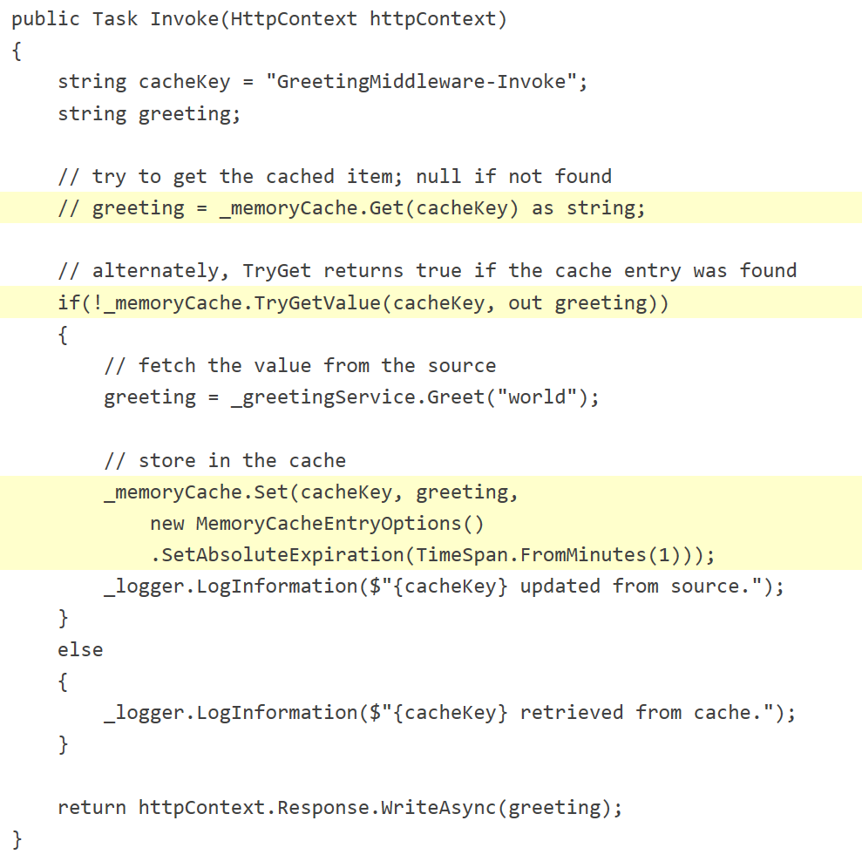
In-Memory Caching
Example of Caching used by Middleware

Slide 76
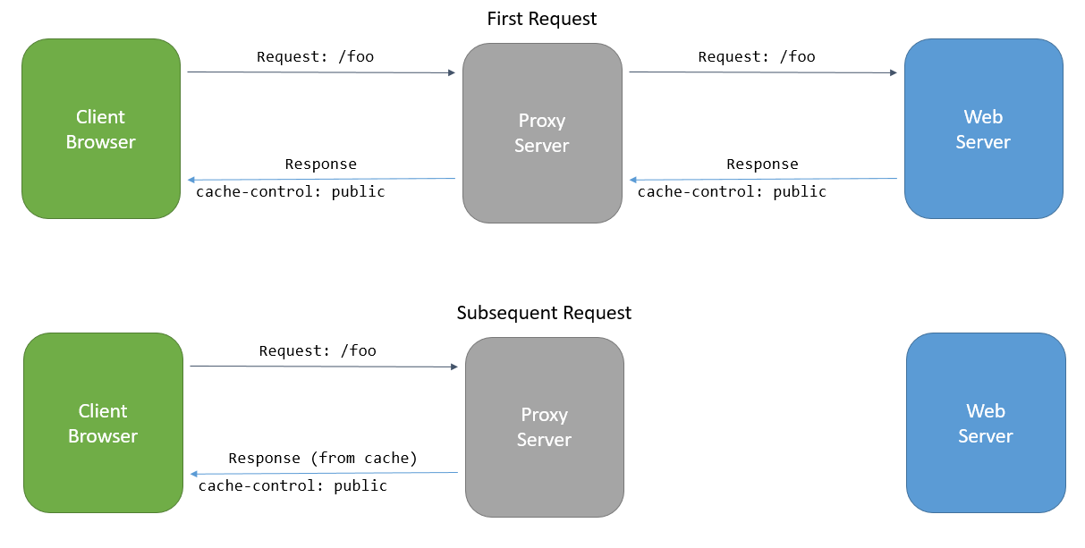
Response Caching
Notes:
Original documentation https://docs.asp.net/en/latest/performance/caching/response.html
https://docs.microsoft.com/en-us/aspnet/core/performance/caching/response?view=aspnetcore-3.1

Slide 77
Demo: In-Memory Caching
Notes:
Demo Objective: Demonstrate the basics of InMemory Caching. We will inject the MemoryCache service and add a message which will regenerate at maximum once ever 20 seconds.
Demo Script:
Open Project CachingDemo from Demos\Module 03 – Controllers\CachingDemo
This project was created using the MVC Template with only slight modifications
Open Startup.cs and show ConfigureServices. Notice that we had added AddMemoryCache
Open Views -> Home -> Index.cshtml
Notice that we have added @ViewBag.CachedMessage. This is just a string we are passing to our View during each request
Open Controllers -> HomeController.cs
In the constructor notice the IMemoryCache parameter which is being passed thru Dependency Injection
Next examine the code in Index()
This code will check to see if our cache has a particular value stored in _dataKey
If it does not contain the key, then it generates the message using DateTime.Now and stores the result
The Cache is configured to SlidingScale of 4 seconds and AbsoluteScale of 20 seconds.
Thus we get a request ever few seconds, the cache will live for a total of 20 seconds.
But if we go more than 4 seconds without a request, the cache will expire.
Finally notice we are logging for cache hits & misses
And stuffing the message into CachedMessage viewbag.
Run the application and demonstrate the caching.
Repeatedly request the page, notice that it takes the full 20 seconds for the message to change.
Wait 5 seconds before requesting again and notice we can update quicker if the sliding scale does not trigger.

Slide 78
Module 3: Controllers
Section 4: Advanced Topics
Lesson 1: Error Logging Middleware

Slide 79
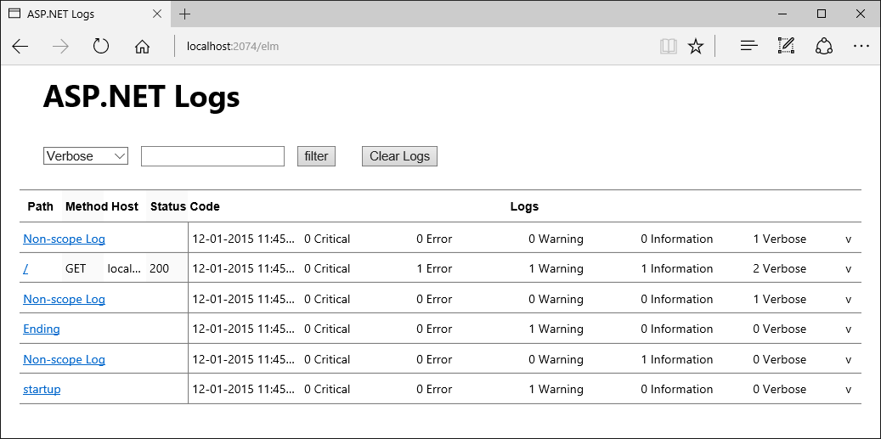
Error Logging Middleware (ELM)
Microsoft.AspNetCore.Diagnostics.Elm
Notes:
Error Logging Module, like ELMAH for previous versions of ASP.NET, is about having a page on the site for an admin or developer to see recent log entries.

Slide 80
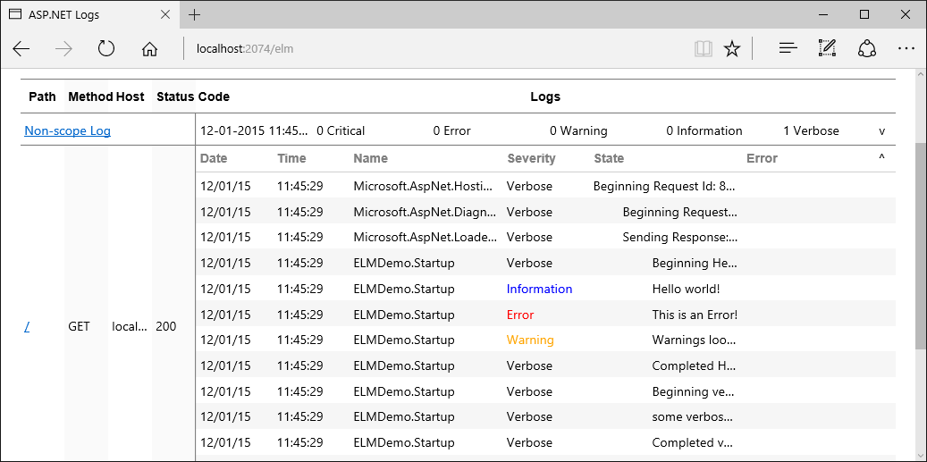
ELM Logs

Slide 81
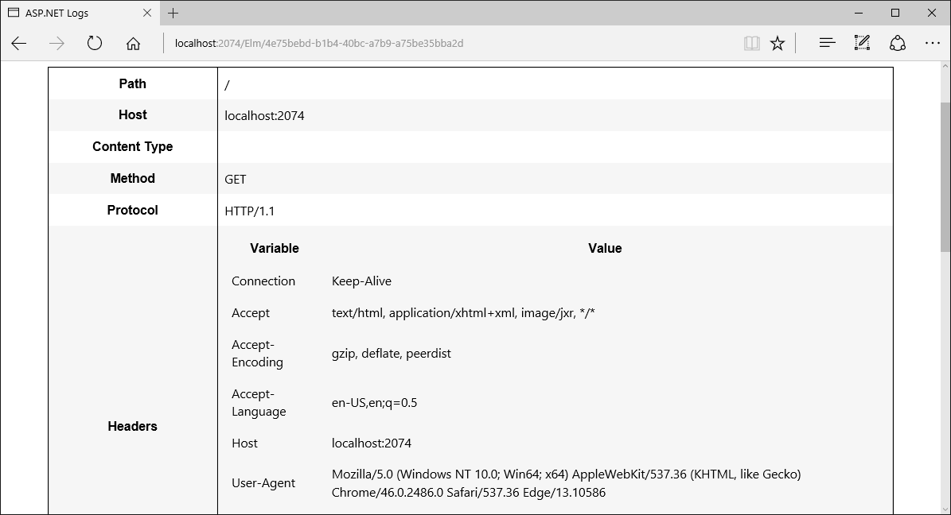
ELM – Request Details

Slide 82
Demo: Error Logging Middleware (ELM)
Notes:
Demo Objective: Quickly explore some of the information collected using Error Logging Middleware.
Demo Script:
Open Project ELMDemo from Demos\Module 03 – Controllers\ELMDemo
This project was created using the Empty Project Template
Walk Thru The Solution
Under Dependencies -> Packages. Show that we have added Microsoft.AspNetCore.Diagnostics.Elm
Show HelloWorldMiddleware.cs
We have added a very similar middleware class which performs some very similar logging and returns Hello World
Show Startup.cs
In ConfigureServices we have added some configuration for ElmService and specified we want Debug LogLevel
In Configuration
UseElmPage enables viewing the actual logs
UseElmCapture enables the ElmMiddleware which captures the request info
We perform some “Startup” logging
Finally, we add our HelloWorld Middleware
Run the Application
Make another request such as https://localhost:44342/SomeOtherRequest
Now click Elm Logs
Notice the URL /Elm is handled by our Elm Page Middleware
Click the down arrow on the right to expand some of the requests.
Show the Scoped log entries produced by the Middleware.
Clicking any path will show more request details.

Slide 83
Module 3: Controllers
Section 5: Summary
Lesson: Best Practices & Summary

Slide 84
Controller Best Practices
Keep controllers lightweight
Use filters
High Cohesion
Make sure all actions are closely related
Low Coupling
Controllers should know as little about the rest of the system as possible
Simplifies testing and changes
Notes:
A few best practices to keep in mind when developing Controllers
Keep Controllers Lightweight.
Business logic / rules belong in Models
Presentation logic belongs in Views.
If we have cross-cutting concerns for many controllers or action methods, extract those into Filters
We want to seek High Cohesion between the parts of our Controllers.
We want logical grouping of related actions. This includes the views related to a particular controller
Finally strive for low coupling between model, views and controllers.
Take advantage of Dependency Injection
This allows multiple people to work on different components at the same time
Allows for simplification of testing and application changes.
https://en.wikipedia.org/wiki/Model%E2%80%93view%E2%80%93controller

Slide 85

Module Summary
Controller and its role in MVC pattern
Controller development
Action methods
Action filters
Dependency Injection
Controller best practices

Slide 86
Lab: Controllers

Slide 87


